Slide 1

HDV: TEST and LINK
Robert Gish MD, FAASLD, AGAF, FAST
Robert G Gish Consultants LLC – Principal
Hepatitis B Foundation - Medical Director
Adjunct Professor of Medicine:
University of Nevada Las Vegas
University of Nevada Reno
UCSD Skaggs School of Pharmacy and Pharmaceutical Sciences

Slide 2
Disclosures
Please see www.robertgish.com
Consultant at Eiger BioPharmaceuticals
    Options
Other disclosures at robertgish.com

Slide 3
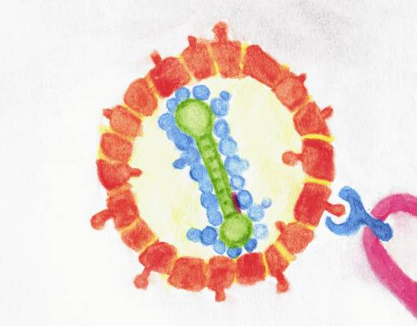
The Hepatitis Delta Virus and Interaction with HBV
HDV-RNA
The smallest of all animal viruses
Highly paired – rod like structure
No native viral enzymes but Ribozymes
Only encodes S-HDAg
HBsAg
HBsAg particles can self assemble
HBV: 1 virion x 10³-10⁶ particles
HDAg
2 forms: S-HDAg and L-HDAg
S-HDAg: ↑ replication
L-HDAg: ↑ assembly (↓ replication)
Calle Serrano, Manns & Wedemeyer, Seminars in Liver Disease 2012
Notes:
HDV: HBsAg for entry and release ! Not replication !
Drawn by Bea Calle Serrano – Introduce Bea (fellow in our group at Hannover Med School, working with Heiner Wedemeyer on Hepatitis Delta, now with Markus Heim in Basel)
HDV is a fascinating virus, the smallest animal virus, needs Hepatitis B virus, namely the surface antigen to „surivive“ especially for entry
HDV is highly infectious

Slide 4
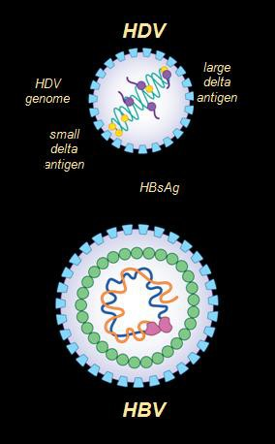
Hepatitis Delta Virus = HDV = Delta Hepatitis:
The Most Severe Form of Chronic Viral Hepatitis
HDV leads to the most severe form of viral hepatitis
  More rapid progression to liver cirrhosis
  5-7x more likely to develop cirrhosis and vs HBV
HDV is always associated with HBV Infection
  Defective virus that needs HBsAg for propagation
No FDA approved Rx for HDV
HDV worldwide prevalence is 15 - 20 million
  Approximately 4-6% of HBV population is infected with HDV
  Orphan disease in US and EU

Slide 5
Introduction
Epidemiology of HDV:
Approximately 5% of patients with HBV have delta infection; however, any recent prevalence data is largely lacking due to very low level testing
Estimates vary depending on risk factors and location:
  Some high-risk populations such as IVDU with rates as high as 50% vs 1-2% in low risk HBV populations
  In patients with chronic HBsAg hepatitis, the pooled prevalence of HDV was 47.36% in Somalia, 24.37% in Egypt, and 8.15% in Saudi Arabia.
Ahn J, Gish RG. Hepatitis D Virus: A Call to Screening. Gastroenterol Hepatol (N Y). 2014;10(10):647–686.
Rizzetto M. Hepatitis D Virus: Introduction and Epidemiology. Cold Spring Harb Perspect Med. 2015;5(7):a021576. Published 2015 Jul 1. doi:10.1101/cshperspect.a021576

Slide 6
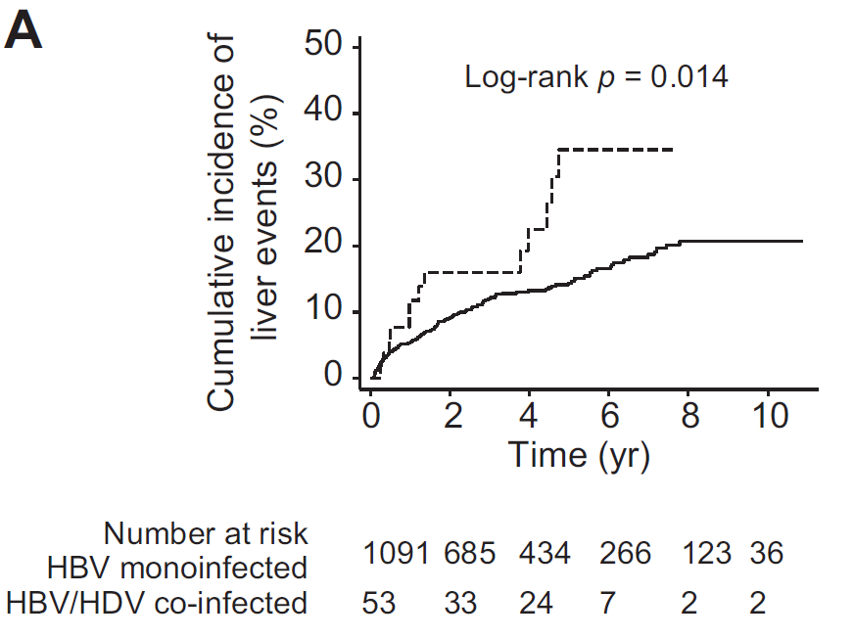
1-2 decades later: Hepatitis Delta still takes a more severe
long-term course than HBV mono-infection
HDV/HBV
HBV
Manesis et al., J Hepatol 2013

Slide 7
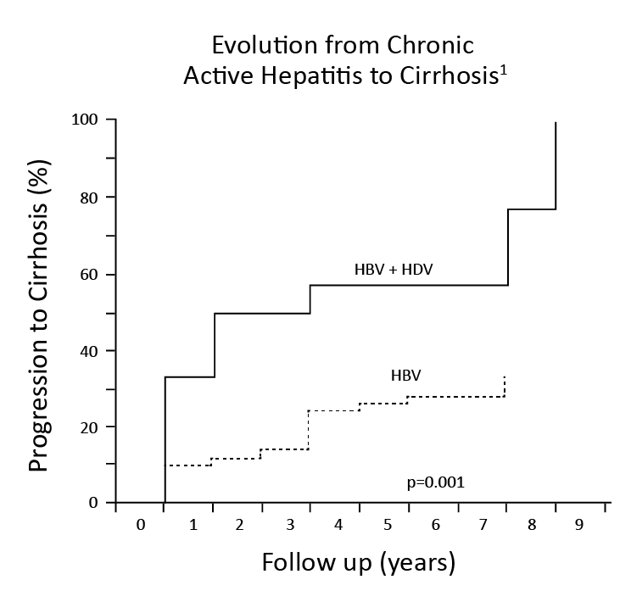
HDV has a much faster progression to Cirrhosis compared to HBV monoinfection !
HBV + HDV
Progression to Cirrhosis (%)
HBV
P = 0.001
Follow-up Years
Fattovich et al, J Infect Dis, 1987; Fattovich et al, Gut, 2000.

Slide 8
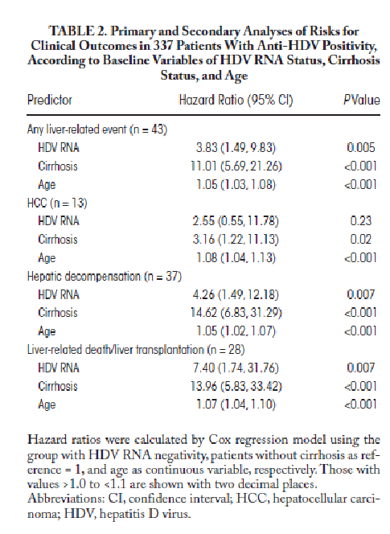
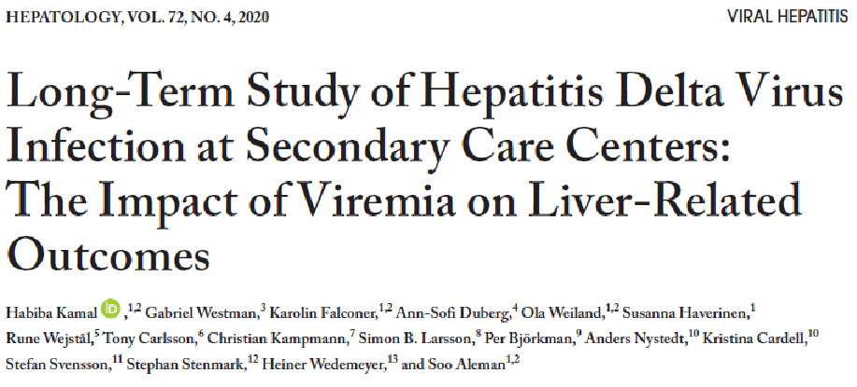

Slide 9
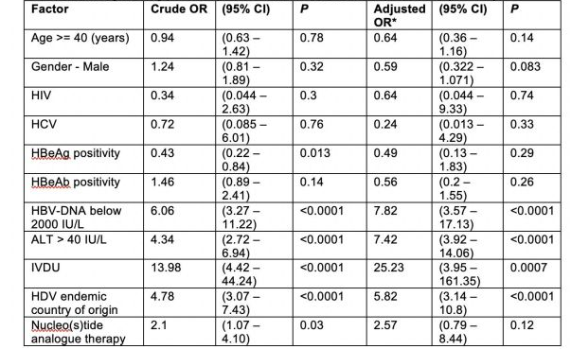
Univariate and multivariate analysis of the risk factors associated with HDV infection among HBsAg positive patients who were checked for HDV Ab
(n = 588)

Slide 10
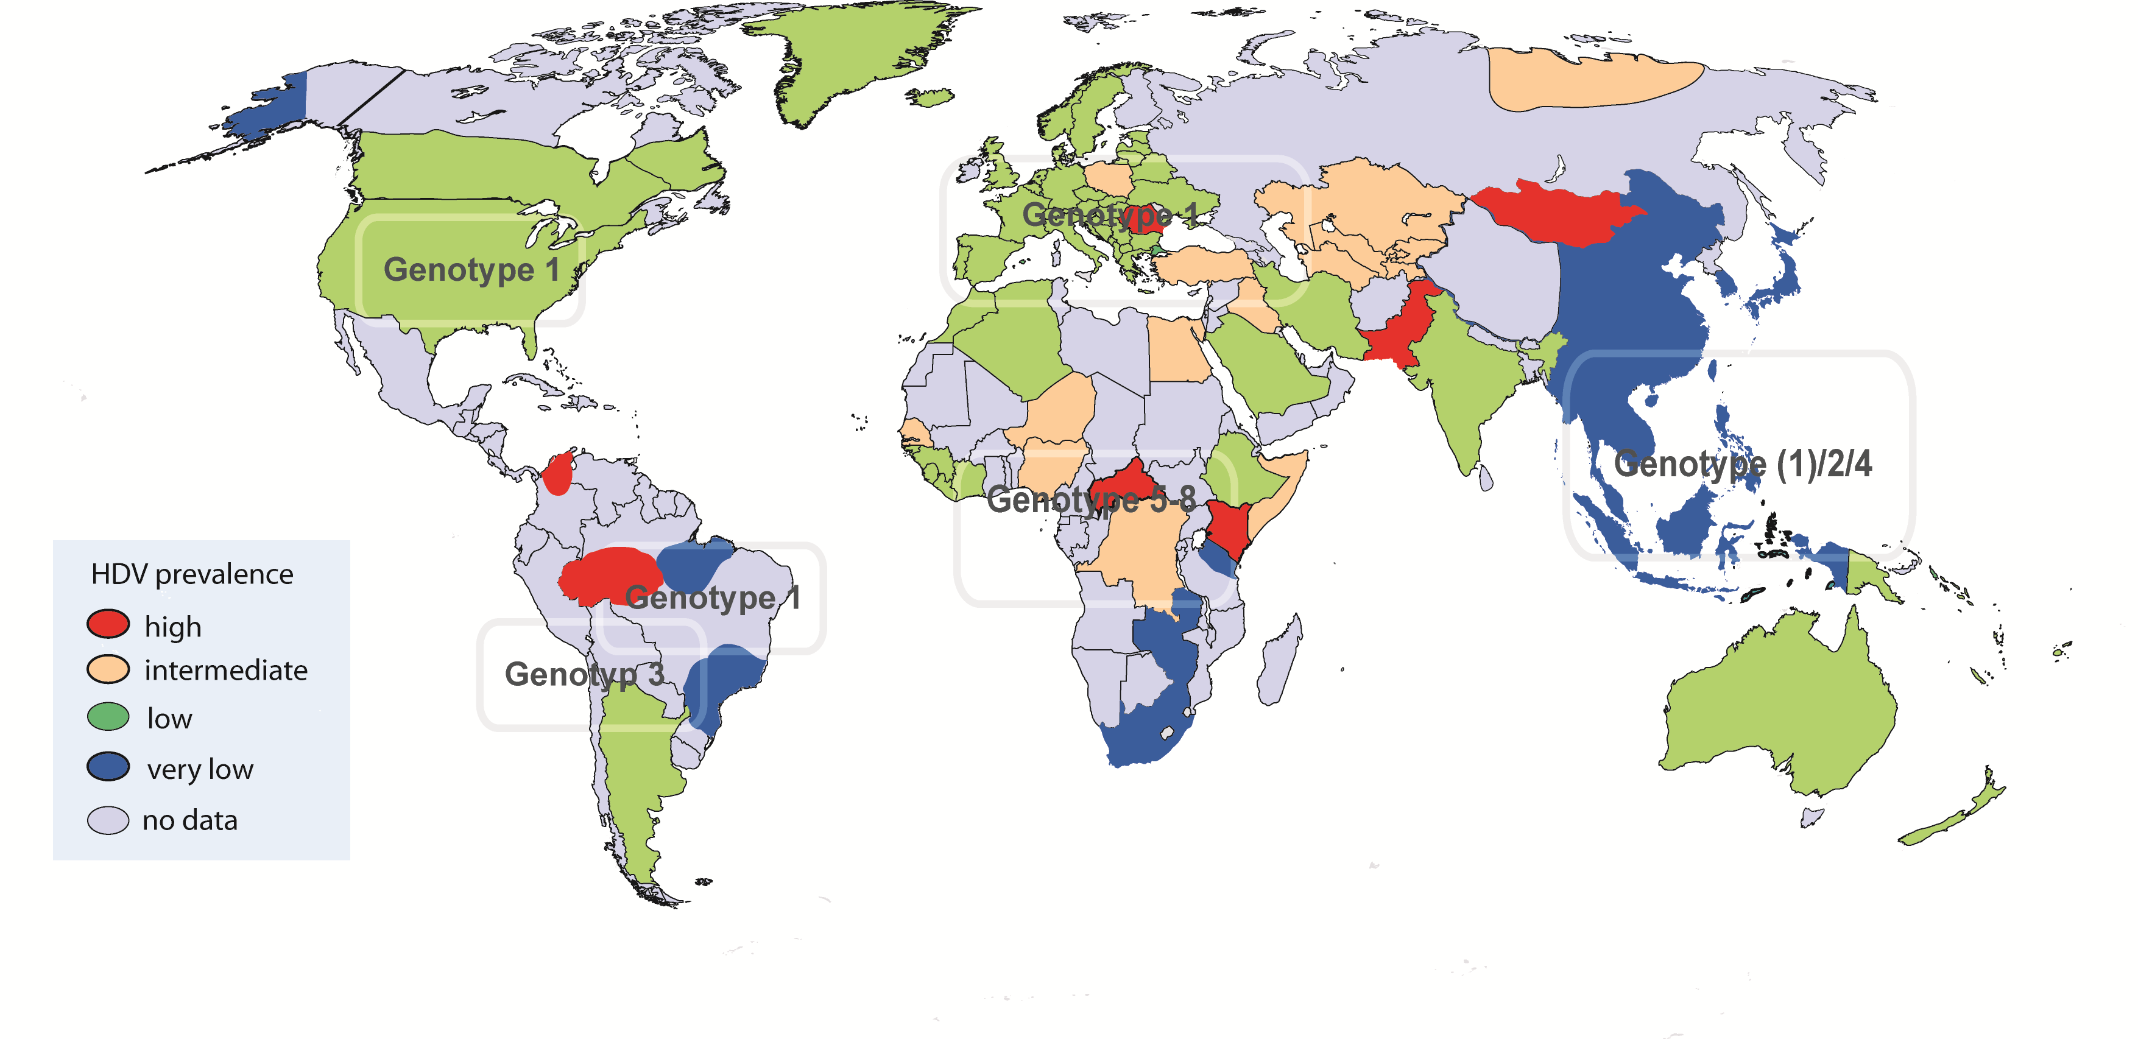
Prevalence of Hepatitis Delta by Genotype
15-20 million patients with chronic hepatitis D (delta): 100 to 150 K US, 200+ K EU, 2 M China
www.hepatitis-delta.org
Notes:
Is this really relevant or just a rare disease we do not need to spend too much time on...
Thus, we need to look to the epidemiology of HDV infection. We estimate 15-20 million patients that are chronically infefetced with HDV. Mario will let us know which consequences this will have. By looking to the global distribution it becomes clear that we have hot spots where this disease is dramtatic. One of the hot spots that are also relevant for Germnay as many of our patients are from this country is Turkey. I am happy that Cihan Yurdaydin is the last but not least speaker in our faculty. He will cover the treatment part. You will see that treatzment is challenging and that we ar efar from the situation where we are in HBV or HCV.
Waht about countries in Central Europe with not so high prevelace data? Do we actually see a vanishing disease that does not need to bother us anymore since the introduction of HBV vaccins?

Slide 11
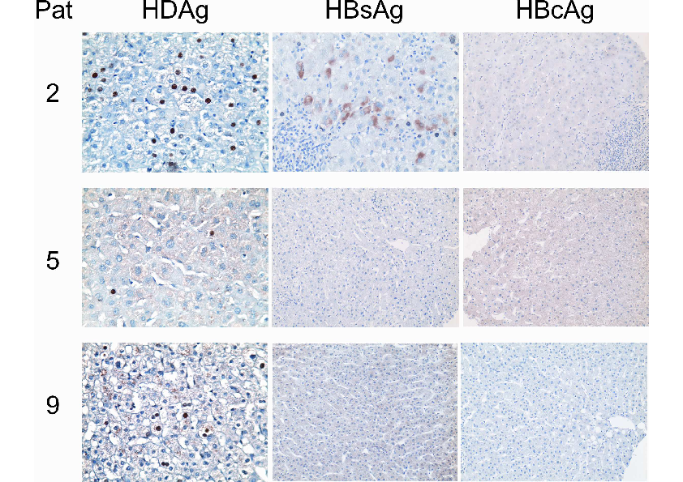
Prolonged intrahepatic persistence of HDAg after liver transplantation!
HDAg stained positive in transplanted livers in 6/26 patients in the absence of liver HBV DNA/cccDNA, serum-HBsAg, and HDV RNA for up to 19 months after LTX.
Mederacke et al., J Hepatol. 2012 Jan;56(1):115-22

Slide 12
Why wait for HBV cure? Treat HDV NOW !
NUCs have no antiviral HDV effect
Faster progression
IFN is only effective in 20-30% (late relapse)
Side effects
Orphan Disease

Slide 13
Reducing HDV-RNA with IFNa Improves Survival
Improved Clinical Benefit without Clearance of HDV-RNA
Interferon-α for 48 weeks with 15 year Follow Up
Change in HDV-RNA
Survival
Log Change in
Serum HDV-RNA
Proportion of
Patients
Surviving
n=36
P = 0.009
Years after Termination of Therapy
Farci et al, Gastroenterology 2004: Long-Term Benefit of Interferon-α Therapy of Chronic HDV: Regression of Advanced Hepatic Fibrosis

Slide 14
IFNa-treated patients developed clinical endpoints less frequently
N=136 patients with chronic hepatitis delta
Follow-Up >6 months (median FU 5.2 yrs)
1,0
0,8
n=52 (38%) IFNα
Log rank: p<0.01 vs NA
IFNα
Log rank: p=0.05 vs no therapy
0,6
Cum. event free survival
0,4
0,2
n=39 (29%) no therapy
n=45 (33%) only NUCs
NA
No therapy
Log rank: p=0.02 vs NA
0,0
0,00
5,00
10,00
15,00
20,00
time (years)
A. Wranke et al., Hepatology. 2017 Feb;65(2):414-425.)

Slide 15
Treatment of Chronic Hepatitis Delta:
Only PEG-IFN leads to decline of HDV RNA
Wedemeyer, Yurdaydin….Manns New Engl J Med 2011, 364(4); 322-31

Slide 16

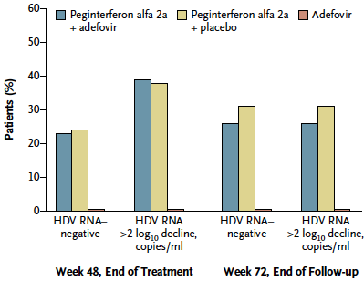
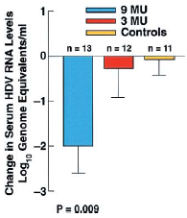
EOT HDV RNA ≥ 2 Log Decline Improves Survival
Of 17 pts with post-tx
week 24 HDV RNA
negativity, 9 were HDV RNA (+) at EOT
Wedemeyer, Yurdaydin et al, NEJM 2011
Farci et al, Gastro 2004

Slide 17
Hepatitis Delta: New Therapies
HBV/HDV-Entry inhibitor
Myrcludex B
HDV
genome
large
delta
antigen
PEG-IFN lambda
Uncoating
of virus
small
delta
antigen
Relapse of
Progeny
Nucleic Acid Polymers
REP 2139-Ca
Cytoplasm
Transport
to Nucleus
HDV
genome
Assembly
HBV
surface
antigen
large
HDAg
Prenylation
prenylated
LHDAg
Replication
HDV genome
small HDAg
large HDAg
Prenylation Inhibitor
Lonafarnib
prenylated LHDAg
prenyl moiety
HBsAg
Notes:
REP HBsAg release inhibitors

Slide 18
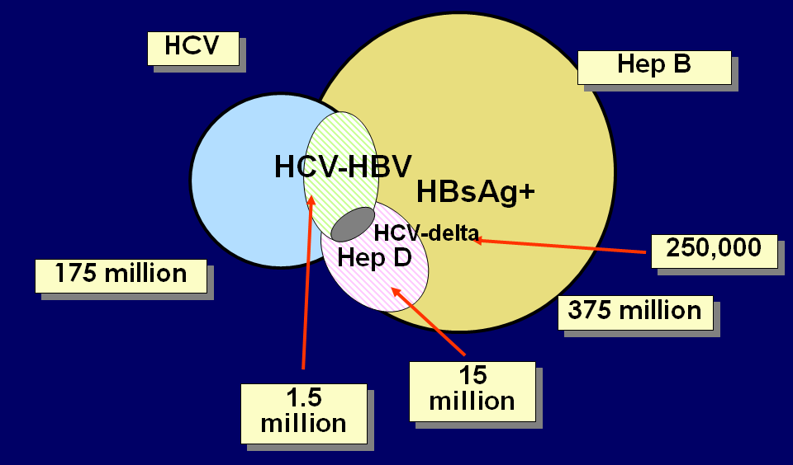
Overlapping HBV, HDV & HCV Epidemics
87
292
?25-30 million
Modified from: Soriano

Slide 19
Ultra-sensitive Abbott ARCHITECT® Assay for HBsAg
LOD = 0.005 IU/mL
3.9 to 14.5-fold more sensitive than comparator assays based on the WHO Standard
Enhanced sensitivity was demonstrated with 27 HBV seroconversion panels
  Detected more panel members (191 of 364) vs. the ARCHITECT® Qual I (144), Qual II (160) and PRISM® (148) HBsAg assays
Detected 7 of 12 HBV DNA (+) / HBsAg (-) samples
Superior HBsAg mutant and genotype detection and specificity, important for the diagnosis and management of HBV infection
S. Lou et al, J Clin Virol 2018 ; 105; 18-25
Notes:
The analytical sensitivity of the improved prototype assay is 5.2 mIU/ml, which is 3.86- to 14.54-fold more sensitive than comparator assays based on the WHO International Reference Standard. The enhanced sensitivity was also demonstrated with 27 HBV seroconversion panels, detecting more panel members (191 of 364) vs. the ARCHITECT® Qual I (144), Qual II (160) and PRISM® (148) HBsAg assays. Further, the assay detected 7 of 12 HBV DNA positive/HBsAg negative samples, and detected all evaluated mutants and genotypes with higher sensitivity than the comparator assays. The improvement in sensitivity did not diminish assay specificity, attaining 100% (95% CI, 99.97-100%) on 10,633 blood donors.

Slide 20
HDV rapid diagnostics – finger stick test from U. Heidelberg
Data from EASL 2019 – Vienna – Lempp, Sakin and Urban

Slide 21
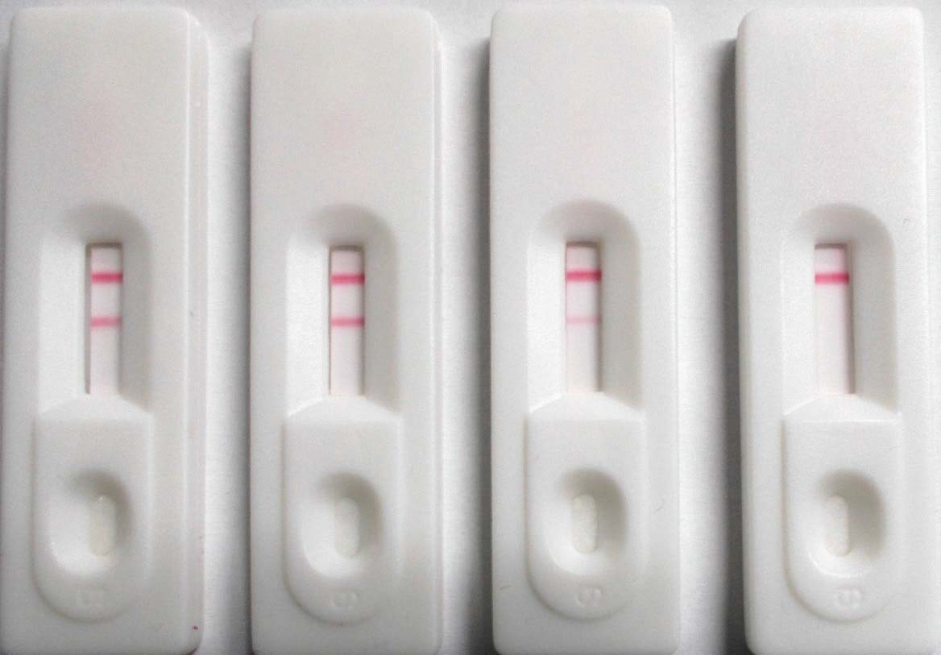
POC test: proof-of-concept
Use of the recombinant HDAg to establish a rapid diagnostic test based on the lateral flow assay (LFA) technique.
control anti-HDV
HDV-pos
HDV-pos 1:10
HDV-pos 1:100
HDV-neg
Proof-of-concept successful! Positive signal up to 1:100-fold dilution
Validation with larger patient cohort necessary
Florian.Lempp@med.uni-heidelberg.de
Florian.Lempp@med.uni-heidelberg.de
HDIN Meeting AASLD 2018 | 10.11.2018

Slide 22
Clinicians Fail to Screen for HDV in Patients with HBV Despite Guideline Recommendations
18th Hepatitis Delta International Network Meeting
Boston, Massachusetts
November 9th, 2019
Andrew Moore, MD
Department of Internal Medicine
Justin Mitchell, MD Nancy Reau, MD
Department of Gastroenterology and Hepatology
Rush University Medical Center
Chicago, IL, USA

Slide 23
Guideline Recommendations
EASL Guidelines for Testing of Hepatitis D:
Initial assessment of subjects with chronic HBV infection:
(6) Co-morbidities, including alcoholic, autoimmune, metabolic liver disease with steatosis or steatohepatitis and other causes of chronic liver disease should be systematically excluded including co-infections with hepatitis D virus (HDV), hepatitis C virus (HCV) and HIV.
EASL 2017 Clinical Practice Guidelines on the Management of Hepatitis B Virus Infection. Journal of Hepatology. 2017; 67: 372 - 373

Slide 24
Guideline Recommendations
AASLD Guidelines for Testing of Hepatitis D
The 2016 HBV Guidelines recommend testing of HBsAg-positive persons at risk for HDV:
HIV infection or HCV infection
Persons who inject drugs
Men who have sex with men
Persons with multiple sexual partners or any history of sexually transmitted disease
Immigrants from areas of high HDV endemicity
HBsAg-positive patients with low or undetectable HBV DNA but high ALT levels should be considered
If there is any uncertainty regarding the need to test, HDV screening is recommended
Recommended screening test is anti-HDV. If this test result is positive, it should be followed by HDV-RNA testing to diagnose active HDV infection.
Terrault, N, et al. Update on Prevention, Diagnosis, and Treatment of Chronic Hepatitis B: AASLD 2018 Hepatitis B Guidance. Hepatology. 2018; 67 (4): 1575 - 1576.

Slide 25
Methods
Retrospective chart review at a tertiary academic institution:
  Dates reviewed: 1/1/2014 - 1/1/2019
  339 patients identified that were HBsAg+
  Demographic information: race, sex, and age
  Of those who were HBsAg+, also identified those who were also HIV+ or HCV-Ab+
  Of those who were HBsAg+, identified if ever screened using the HDV-Ab
Screening rates determined:
  % of those who were HBsAg+ and ever screened for HDV
  % HBsAg+ and HIV+ ever screened for HDV
  % HbsAg+ and HCV-Ab+ ever screened for HDV
  % of screening based on race and sex

Slide 26
Results
Andrew Moore, MD, Justin Mitchell, MD, Nancy Reau, MD, FACG. P0644 - CLINICIANS FAIL TO SCREEN FOR HDV IN PATIENTS WITH HBV DESPITE GUIDELINE RECOMMENDATIONS. Program No. P0644. ACG 2019 Annual Scientific Meeting Abstracts. San Antonio, Texas: American College of Gastroenterology.
Notes:
339 total patients identified as HBsAg+:
• 90 of 339 were screened for HDV (27%)
• 1 of 339 positive for HDV-Ab (0.3%)
Rates of screening in high risk groups:
• 9 patients were also HIV+; 1 patient screened for HDV (11%)
• 13 patients were HCV-Ab+; 1 patient screened for HDV (8%)
Rates of screening by race:
• 111 Black; 29 were screened (26% screened)
• 117 Asian; 37 were screened (32% screened)
• 56 Caucasian; 9 were screened (16% screened)
• 55 were other/unknown race
Rates of screening by gender:
• 206 Male; 58 were screened (28% screened)
• 133 Female; 32 were screened (24% screened)

Slide 27
Discussion
Why are the HDV screening guidelines not being followed?
  Lack of awareness of guidelines
  Perception that HDV is no longer clinically relevant, which is exacerbated studies showing lower than expected prevalence, a result of decreased testing
  Poor availability of diagnostic testing
  Limited treatment options
What are some directions for the future?
  Possibility of screening all HBV patients in an attempt to gather better prevalence data
  If increased screening shows higher prevalence, this may result in increased awareness and thus more emphasis on earlier interventions and development of better treatments
Rizzetto M, Alavian SM. Hepatitis delta: the rediscovery. Clin Liver Dis. 2013;17(3):475–487

Slide 28
HDV Treatments Are Needed –
HDV Cure is the Objective!
HDV is the most severe form of hepatitis
HDV requires only small amounts of HBsAg to complete viral packaging
Theoretically, Sterilizing HBV cure is the only way to obviate a need for an HDV cure
Sterilizing HBV cure: Nowhere in sight, remove all cccDNA and all integrants
Functional HBV cure: Can it be discovered, developed and approved in our lifetime?
  I expect 30% Functional Cure with 4 drug combination therapies, 60% Sustained HBV DNA Suppression and 10% Relapse < 4 years
HDV treatments:
In Phase 3; on track to be approved within the next 2-3 years!

Slide 29
A Long Way to the Promised Land…
AASLD 2019 Conclusions relevant to HDV
Several promising candidates already in Phase II for HBV
  Will CAMs + NUC be enough to clear HBsAg? And clear cure HDV?
  Will siRNAs achieve off-treatment HBsAg loss? And clear HDV ?
  How should the immunomodulators be used? And role with HDV such as lambda interferon
  Will PD1 blockade be safe at the dose needed to clear HBsAg? And have a role in HDV?
  Which combinations should be prioritized in Platform studies and in which patient populations? For HDV ? Treat all ?
HBV Forum 6, Boston Nov 2019

Slide 30
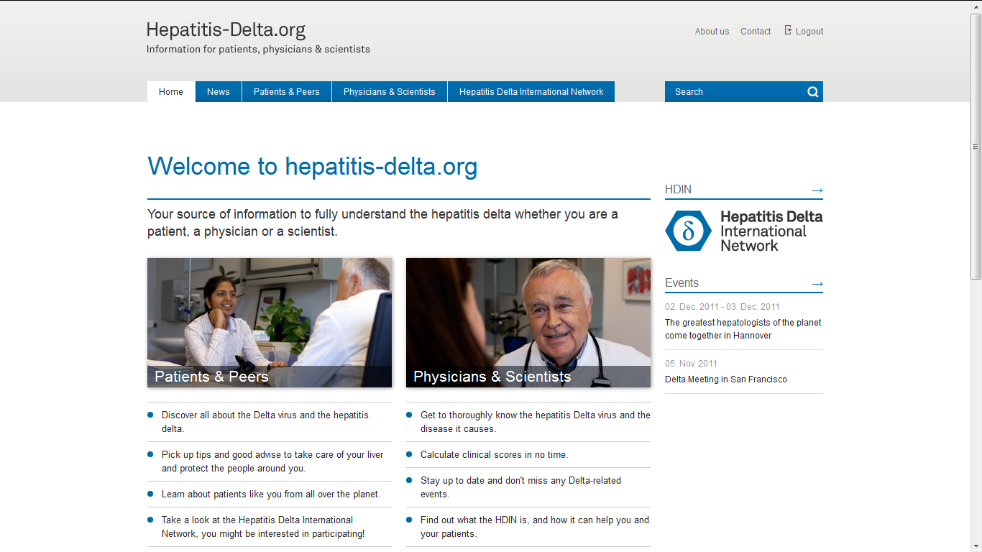
The Hepatitis Delta International Network - HDIN
Regular meetings
at
EASL and AASLD
www.hepatitis-delta.org
sponsored by the German Center for Infection Research DZIF

Slide 31
Conclusions for 2020 and Beyond
HDV in underdiagnosed
All HBsAg+ patients should be tested for HDV by antibody testing
Need rapid test on the global market
No difference in Genotype in terms of response to interferon but some genotypes not studied
HDV has poor testing frequency and very low linkage to care
Best treatment today is INF with MVR rate of 20%, this does not define cure of HDV
Major need for new therapies to result in MVR/SVR/DVR, or 2 log reduction = reset of disease activity
New therapies with INF/Combination
Lambda, Lonafarnib, vs Myr, Vs STOP/NAPs vs HBsAg clearance
Next HBV therapies will have 40% HBsAg loss, new HDV therapies will have a MVR/SVR of 40% with an additional 20% set of patients who will have a “reset” of virus levels by 2 logs
HDV may survive with other viruses: we must keep looking with HDV PCR testing

Slide 32





Thank You!
Connect with us!
Hepatitis Delta Connect Website:
www.hepdconnect.org
Twitter, Facebook, Instagram
@hepdconnect
Still have Questions?
Email us at connect@hepdconnect.org

