Slide 1
The Anti-Vaccine Movement: Arguments and Answers
Dorit R. Reiss

Slide 2
Plan:
Typical Arguments:
Fears that vaccines can harm.
autism
Too Many Too Soon
Toxins
My child my choice: No one’s business.
Assessing Sources
Why Counter?

Slide 3
Common Vaccine Myths/Distortions
Vaccines have major side effects like: sudden infant death syndrome (SIDS), allergies, asthma, diabetes, autism, mental retardation.
Not true
Vaccines overload the immune system (spacing out or delaying vaccines can help avoid this).
Not true
Vaccines contain toxic ingredients
Not true

Slide 4
Safety Concerns: Adverse Reactions:
Fact: Studies show vaccines do not cause SIDS (Vennemann et al, 2007, Kuhnert et al, 2012, Müller-Nordhorn et al, 2015).
Myth: Baby dies after vaccines – belief: because of vaccines.
Why wrong? Correlation v. Causation: SIDS: by chance alone, “we estimated that a case of SIDS will occur when vaccination was given in the last 24 hours in 1.7 cases per year and within 48 hours in 3.5 cases.” (Brotherton et al, 2005)

Slide 5
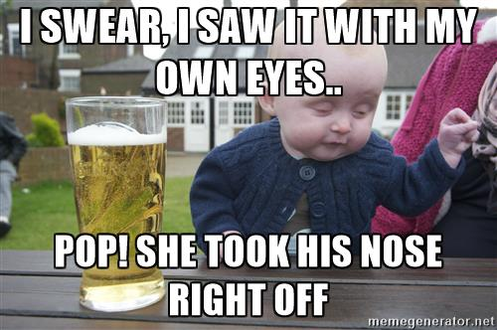
Safety Concerns: Adverse Reactions:
Correlation v. Causation:

Slide 6
Safety Concerns: Adverse Reactions: Autism
Studies in millions of children found no link between vaccines and ASD. (Gerber and Offit, 2009)
False idea of a link persisted, even after proof shows otherwise, even after one of main player, Andrew Wakefield, lost license for misconduct.
Misconceptions about MMR promoted by anti-vaccine

Slide 7
Measles v. MMR:
Risks of Measles: | Risks of MMR:
Ear infections Croup Diarrhea 5% pneumonia 1:1000 encephalitis, almost 50% mortality 1-3:1000 deaths SSPE: United States: 7-11 per 100,000 Germany: 2003-2009 1:1750-3300 in kids under 5 | Local reactions Fever Febrile Seizures ITP: 1:24,000, usually temporary. Severe allergic reaction 1: 1.5-1.8 million.

Slide 8
2011 Institute of Medicine report confirms that vaccines are safe & have few side effects.
“…the most comprehensive, most careful analysis of all of the literature looking at these eight vaccines that has ever been done”
Dr. Ellen Wright Clayton
IOM committee chair
August 2011
"The big take-home message is that we found only a few cases in which vaccines can cause adverse side effects, and the vast majority of those are short-term and self-limiting.”
http://www.iom.edu/Reports/2011/Adverse-Effects-of-Vaccines-Evidence-and Causality.aspx
Notes:
Assessment of 1000 peer reviewed research articles to determine if a causal relationship existed between vaccines and health effects.
Ellen Wright Clayton
Craig-Weaver Professor of Pediatrics, Professor of Law Director, Center for Biomedical Ethics and Society at Vanderbilt University, Nashville
Report published Aug 25th 2011
The 18 committee members included pediatricians, biostatisticians and medical doctors and researchers in several fields, including immunology and neurology
Committee members were from academic institutions across the country
Vaccines assessed - mumps, measles and rubella (MMR); chicken pox; influenza; hepatitis A; hepatitis B; human papillomavirus (HPV); diphtheria, tetanus and pertussis (DTAP); and meningococcus.
Committee reported that there was no evidence for a causal link between MMR and autism, the flu vaccine and asthma, the flu vaccine and Bells Palsy, MMR and T1D, DT or TT or aP containing vaccines and T1D

Slide 9
Common Vaccine Myths/Distortions
Vaccines have major side effects like: sudden infant death syndrome (SIDS), allergies, asthma, diabetes, autism, mental retardation.
Not true
Vaccines overload the immune system (spacing out or delaying vaccines can help avoid this).
Not true
Vaccines contain toxic ingredients
Not true

Slide 10
Vaccine Schedule, 2016

Slide 11
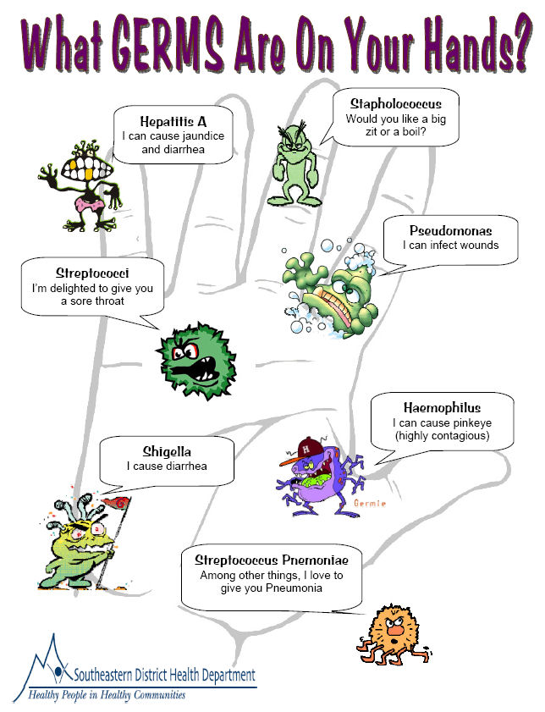
Can all the vaccines overwhelm the immune system of an infant?
No….Why?
The infant immune system can respond to many microbes.
T and B cells have the capacity to recognize many more antigens than anyone will ever be exposed to.
Babies are surrounded by potential pathogens
~1,800 bacteria in the air we breath each day*
* Anderson et al., 2006.

Slide 12
Reduction in number of antigens in vaccines over the past 100 years
Year
Vaccines
Total number of antigens
1900
Smallpox
200
1960
Smallpox, Diphtheria, Tetanus, Pertussis, Polio
3217
1980
Diphtheria, Tetanus, Pertussis, Polio, Measles, Mumps, Rubella
3041
2000
Diphtheria, Tetanus, Pertussis, Polio, Measles, Mumps, Rubella, Hib, Varicella, Pneumococcus, Hepatitis B
126
Source: Offit, Gerber and Hackett. Addressing Parents’ Concerns: Do Multiple Vaccines Overwhelm or Weaken the Infant’s Immune System. Pediatrics January 2002
Notes:
antigens - microbial proteins and polysaccharides

Slide 13
Common Vaccine Myths/Distortions
Vaccines have major side effects like: sudden infant death syndrome (SIDS), allergies, asthma, diabetes, autism, mental retardation.
Not true
Vaccines overload the immune system (spacing out or delaying vaccines can help avoid this).
Not true
Vaccines contain toxic ingredients
Not true

Slide 14
Safety Concerns: Toxins
Look at insert, Google ingredients.
Find: e.g. Formaldehyde –
“Formaldehyde has been classified as a known human carcinogen (cancer-causing substance) by the International Agency for Research on Cancer and as a probable human carcinogen by the U.S. Environmental Protection Agency.” (National Cancer Institute, http://www.cancer.gov/cancertopics/factsheet/Risk/formaldehyde)

Slide 15
The dose makes the poison:

Slide 16
Natural Sources:

Slide 17
My Child My Choice:
Parental rights?
Parental responsibility!

Slide 18
Assessing Sources:
WHO’s Safety Net Project:
http://www.who.int/vaccine_safety/initiative/communication/network/approved_vaccine_safety_website/en/
CHOP’s VEC: Evaluating Studies:
http://www.chop.edu/centers-programs/vaccine-education-center/vaccine-science/evaluating-scientific-information-and-studies

Slide 19
Why is it important to counter anti-vaccine myths?

Slide 21
Herd Immunity
Need a high percentage of the community to be to vaccinated to prevent a disease outbreak.
Protects individuals who can not be vaccinated.
Also known as community immunity.
At risk community
San Francisco Immunization Coalition
Notes:
CDC – suggests 92-94% of people need to be vaccinated but there are some suggestions it needs to be higher, possibly to account for non/weak responders to the vaccine

Slide 22
Herd (Community) Immunity (2/2)
Protected community
In a protected community, the majority of the population (~90-95%) is vaccinated which limits the ability of a virus or bacteria to spread.
By limiting the ability of a viruses or bacteria to spread individuals who can not be vaccinated (too young, immunosuppressive therapies/diseases or other genetic conditions) are protected.
So though herd immunity the most vulnerable members of our community are protected.
Notes:
CDC – suggests 92-94% of people need to be vaccinated but there are some suggestions it needs to be higher, possibly to account for non/weak responders to the vaccine

Slide 23
Questions?
Join the San Francisco Immunization coalition
http://www.sfimmunizationcoalition.org/
Follow us the San Francisco Immunization coalition on Facebook
https://www.facebook.com/immunizesf/
23

