Slide 1

Understanding your Neighbor: Vaccination Advocacy Through Community Coalition Building
September 15, 2017

Slide 2
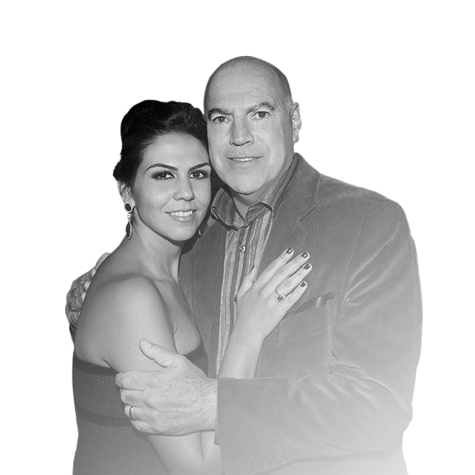
“We’re in the middle of a giant paradigm shift in cancer.
We’re finally, after decades, moving to a new era... and we’re moving the needle in a big way.”
Ralph V. Whitworth, IF Co-Founder (1955 – 2016)
Notes:
I think we should highlight or put a bright border around the Educational Programming column, as that is what people want to hear from us about.

Slide 3
Immunotherapy Foundation’s initial mission is to prevent, treat, and, ultimately, cure HPV-related cancers.
Notes:
I think we should highlight or put a bright border around the Educational Programming column, as that is what people want to hear from us about.

Slide 4
Strategic Initiatives
IF is dedicated to eradicating HPV-related cancers by taking a three-pronged approach:
Research Funding
Catalyze research progress by:
Seeding fundamentally sound, yet financially starved research projects that show promise for sustainable discovery
Proactively engaging to improve focus, communication, accountability, and advocacy
Educational Programming
Reduce the risk of HPV through available preventative applications (vaccination and screening):
Launch pilot HPV study and education program in San Diego
Provide online resources through IF’s website and social media platforms
Patient Support
Empower patients to navigate their care and treatment options:
Provide comprehensive information on efficacy of immunotherapy treatments, malignancy applications, and resources for finding open clinical trials
Support and respond to patient inquiries

Slide 5
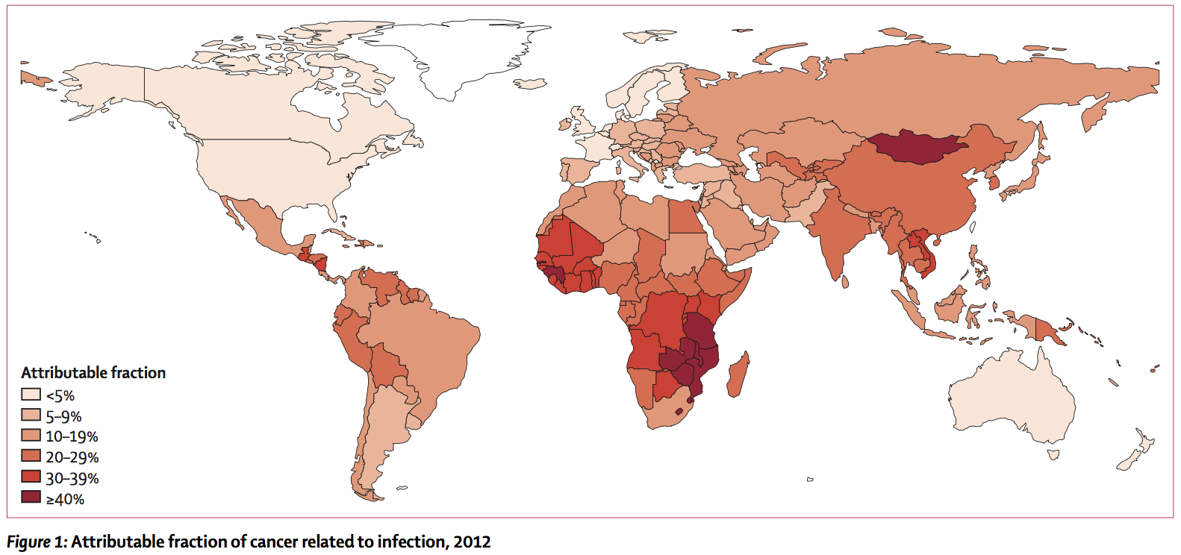
Pathogen-Driven Cancers: A Global Crisis
In 2012, of the estimated 14M new cancer cases worldwide, 2.2M (15.4%) were
attributable to infection.
and
Nearly 100% of cervical cancers were caused by HPV.
Notes:
Graphic and data sourced from The Lancet Global Health, 2016: “Global burden of cancers attributable to infections in 2012: a synthetic analysis”

Slide 6
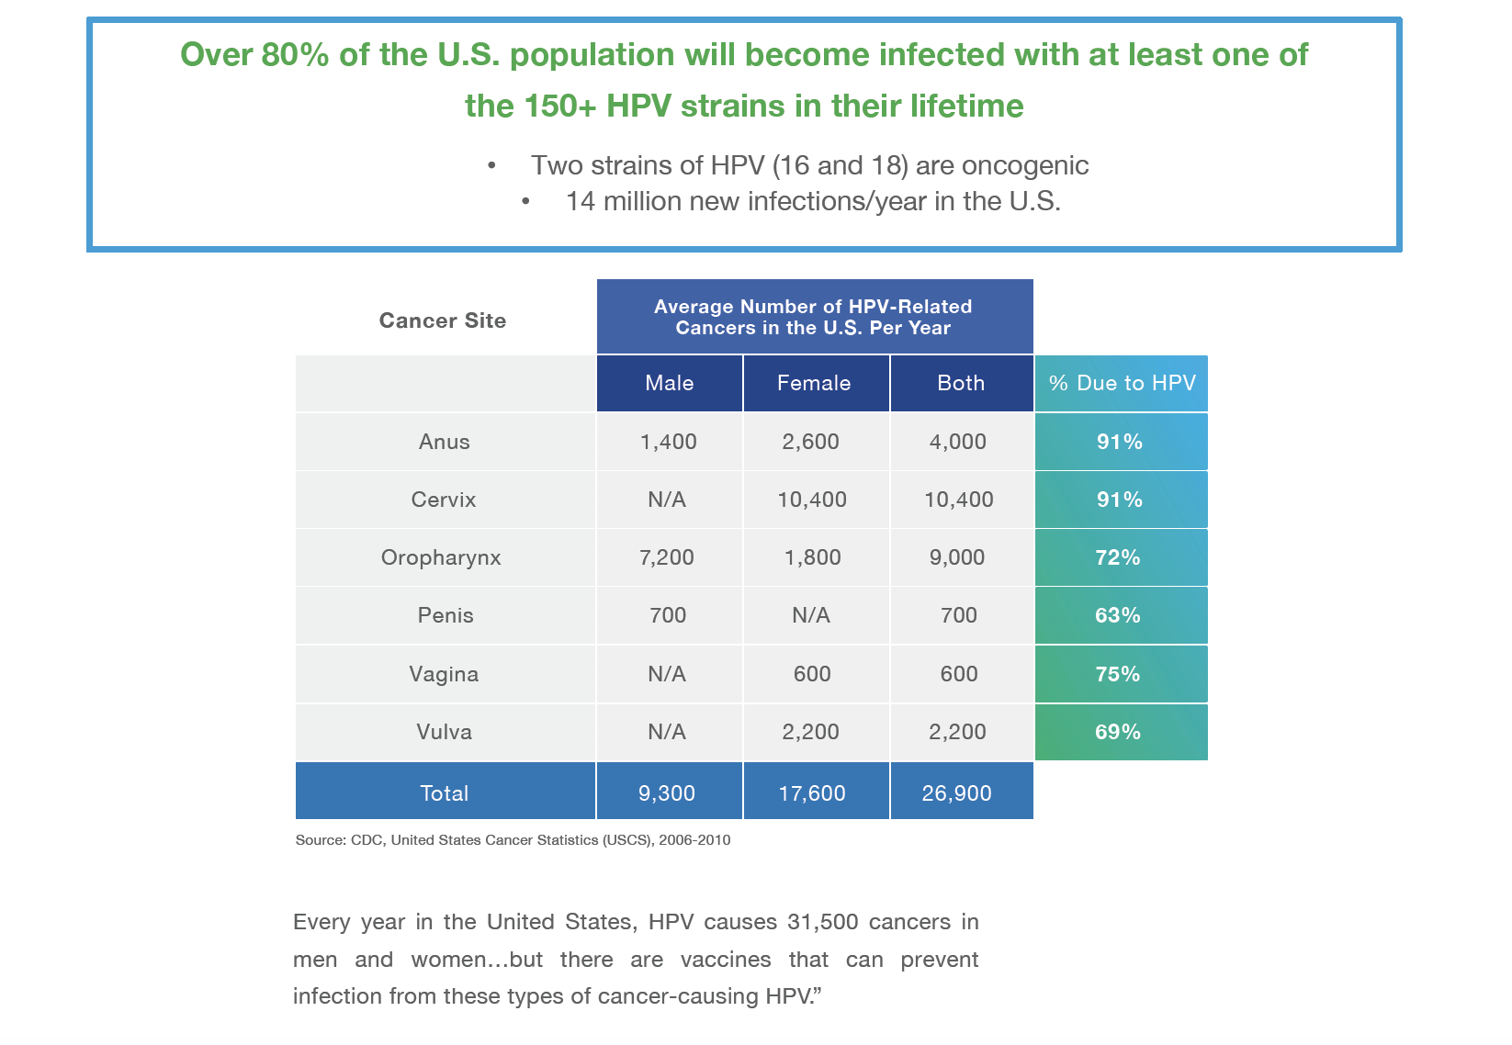
The U.S. HPV-Associated Cancer Burden

Slide 7
Impending U.S. HPV-Related Cancer Crisis in Men
Oropharynx
(base of tongue)
Oropharynx
(tonsil)
Anus

Slide 8
HPV Vaccination Rates in the U.S.
In 2016, the CDC reports that only 43% of teens are completing their HPV vaccination cycle.
Overall, 60% of teens aged 13-17 years received one or more doses of HPV vaccine, an increase of 4 percentage points from 2015. [1][2]
This is progress, but still far below the desired 80% rate to achieve herd immunity and prevent cancers for this coming generation.
Notes:
California data pulled from California Department of Public Health contacts. Will cite as such but waiting for feedback from CDPH to associate it to a specific report or study and make sure this is publically available data.

Slide 9
“Immunization is something that many people think of as personal, but it is actually part of being in a society.”
Andrew Pollard, Professor of Pediatric Infection and Immunity, University of Oxford
Notes:
California data pulled from California Department of Public Health contacts. Will cite as such but waiting for feedback from CDPH to associate it to a specific report or study and make sure this is publically available data.

Slide 10
Poor HPV Vaccination Rates: Why?
Our journey into education and advocacy has shown us the low rates are driven by varied reasons, all of which need to be understood and addressed.
To effectively raise rates, we need to understand the different “whys.”
Prevent Cancer Foundation’s Survey Research Executive Summary, January 2016 | MD Anderson HPV Cancer Moonshot Data Presentation | UCSD School of Medicine and Rady Children’s Hospital Presentation
More than half (53%) of adults are not aware HPV can lead to cancer if untreated, and 57% are not aware that the HPV vaccine can significantly reduce the risk of certain cancers. | Providers don’t recommend or don’t recommend strongly enough; may lack knowledge about HPV or the vaccine. Recommend too late, post-exposure. | Sexual stigma – it’s a topic many want to avoid. Pediatricians don’t see or treat the cancers that HPV causes.
Less than 1/5th of African American females and 1/6th of Hispanic adults were aware that each racial group were at respectively higher risks of certain HPV-associated cancers. | Fewer scheduled adolescent doctors’ appts. - fewer opportunities. Poor communication on subject matter. | Multiples vaccine doses make vax cycle tougher to complete than other ‘one and done’ shots. Adolescent population is hard to reach.

Slide 11
Vaccination Uptake: The Impact
The results of this incremental increase in vaccination have translated into a 71% decrease in HPV infection types that cause most HPV cancers and genital warts among teen girls.
Notes:
https://www.theguardian.com/science/2017/jul/24/small-decline-in-mmr-vaccination-rates-could-have-dramatic-effect-experts-warn
https://www.cdc.gov/std/stats/sti-estimates-fact-sheet-feb-2013.pdf
“A small decline in the uptake of vaccines could have a dramatic impact on both public health and the economy, research suggests, as concerns about outbreaks of preventable diseases grow in the US and Europe.”
https://www.cdc.gov/std/stats15/other.htm#hpv

Slide 12
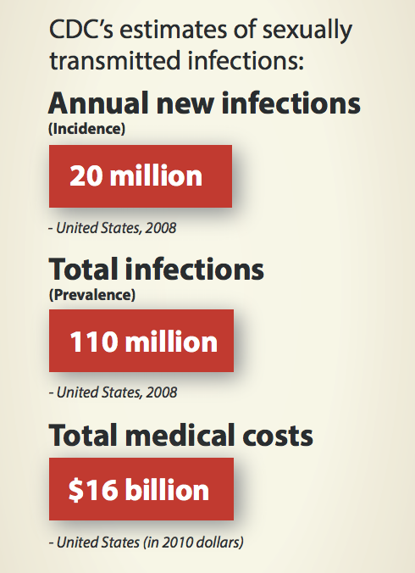
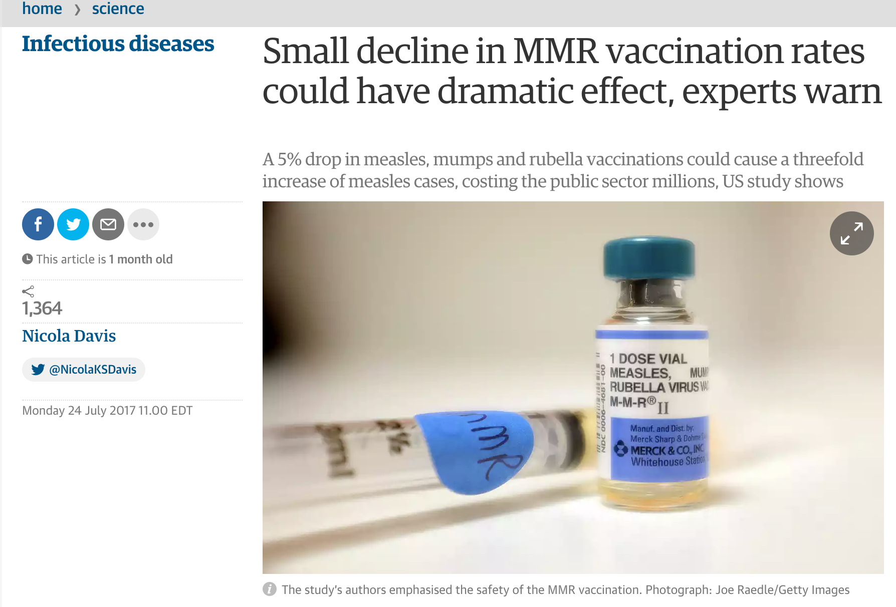
Vaccination Resistance: The Consequences
As shown in this example, even slight percentage point drops can have devastating consequences on disease incidence, quality of life, and public health costs. In the case of the HPV vaccine, the downstream consequences include cancer and associated costs of cancer care.
Notes:
https://www.theguardian.com/science/2017/jul/24/small-decline-in-mmr-vaccination-rates-could-have-dramatic-effect-experts-warn
https://www.cdc.gov/std/stats/sti-estimates-fact-sheet-feb-2013.pdf
“A small decline in the uptake of vaccines could have a dramatic impact on both public health and the economy, research suggests, as concerns about outbreaks of preventable diseases grow in the US and Europe.”

Slide 13
Communal Alignment: Gathering Data in San Diego
Solution | Next Steps
IF has proposed a public health assessment and pilot field study to gather data specific to the populations that make up San Diego county and form a basis for programming content. | To inform study design, IF will work with HPV Think Tank advisors to provide preliminary, qualitative interviews on local challenges in upping HPV vaccination rates. Data will inform study aims and methods.
The study is projected to be executed by SDSU public health students and aided by an IF-initiated HPV Think Tank as an advisory board of San Diego public health and advocacy organizations and individual experts. | Pilot study data will be reviewed with HPV Think Tank advisors and assist with broadening study sites, methods, and helping to define optimal programming outlets for new data.
The HPV Think Tank would advise on upcoming study design and any need for subsequent study, contingent on pilot study results. | The data produced will be used to create evidence-based programming in the form of PSAs, awareness and educational campaigns, and overall messaging around HPV in San Diego county.
Notes:
We could also simplify this down by reducing the Problem piece. Pull from the full study proposal around San Diego population facts. Propose study and HPV Think Tank.

Slide 14
Building Partnerships: Qualitative Interview Samples with Our Collaborators
  How long have you worked in vaccination advocacy?
  Over 25 years in a public health and educational capacity.
  What makes you passionate about this issue and public health?
  One advisor stated that vaccinations were the biggest societal achievement of the 20th century.
  Multiple practicing or former physicians cited treating the illnesses of children who suffer the consequences of non-vaccination as motivation for their advocacy.
  What do you see as San Diego’s biggest and defining unique challenges to upping these vaccination rates?
  Overwhelmingly advisors have pointed to the diversity of population, ethnically, and socioeconomically. The reasons for non-vaccination are fundamentally different between groups.

Slide 15
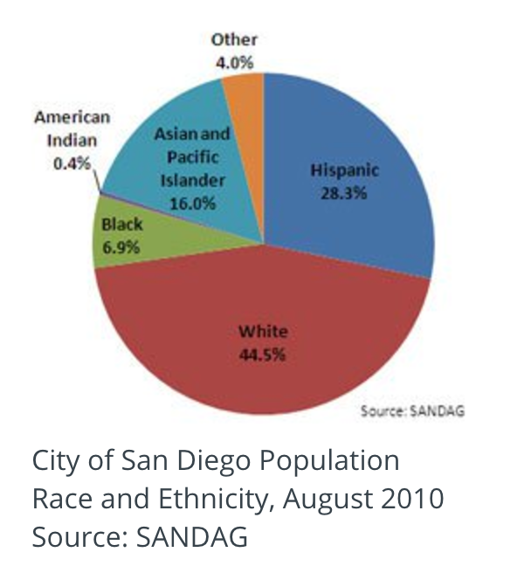
Starting in San Diego
According to city government, the City of San Diego is one of the most ethnically and culturally diverse places in the U.S. More than 100 languages are spoken by San Diego residents whose families have come from all parts of the world.
With more than 1.3 million people, San Diego is the eighth-largest city in the U.S. and the second-largest in California, according to the U.S. Census Bureau.
By 2020, San Diego’s population is forecast to be 1.54 million, with 3.54 million people in the county.
Notes:
https://www.sandiego.gov/economic-development/sandiego/population

Slide 16
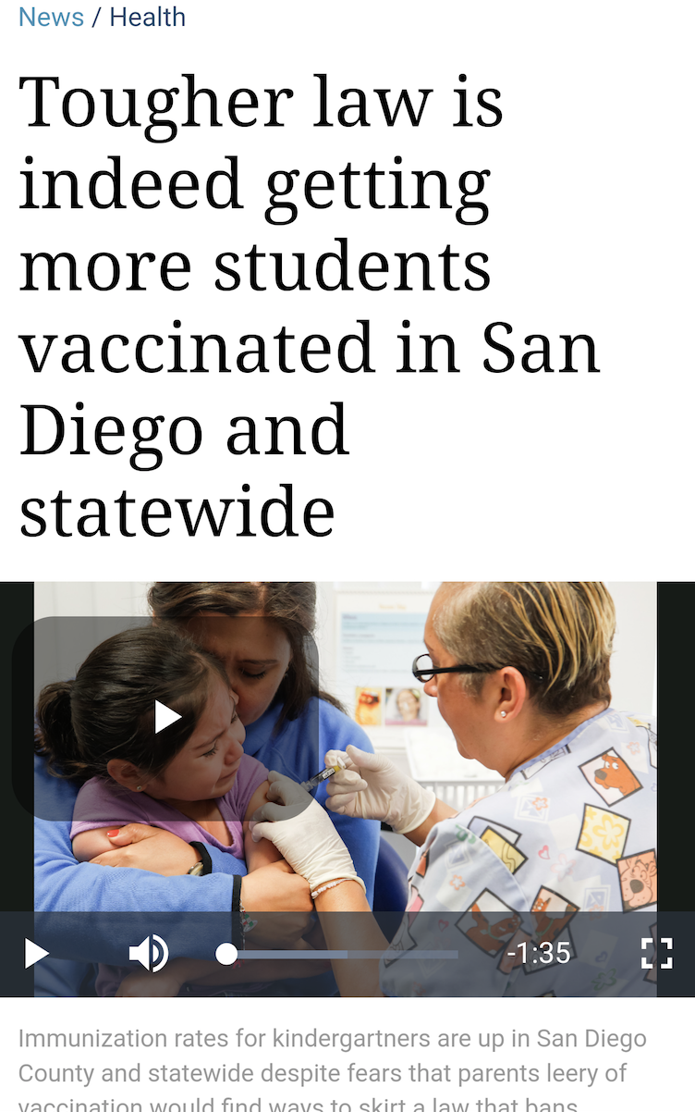
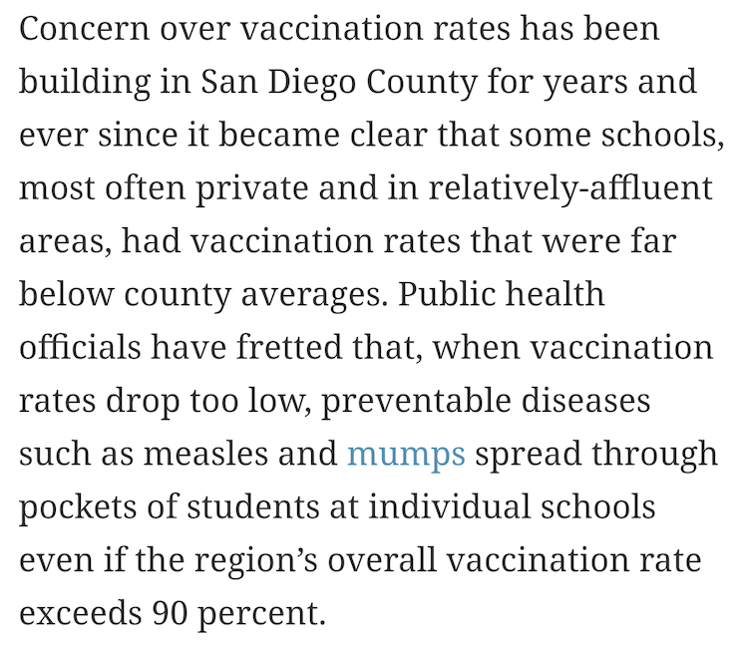
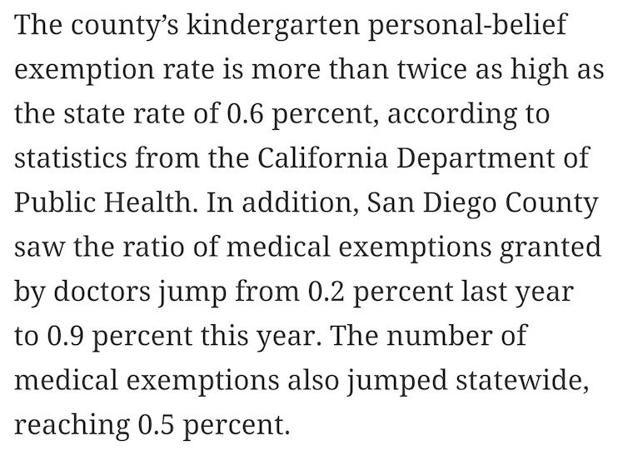
On the Ground: Feedback from San Diego’s Growing Community (April 2017, SD Union-Tribune)
Notes:
https://www.sandiego.gov/economic-development/sandiego/population
Highly diverse community comes from all over the world – some immigrant populations may not have the vaccine in their home country. Some may have preconceived notions or been exposed to supposed adverse effects and suspect that the vaccine is harmful. Knowledge gaps and lack of access to care and regular screenins for lower income communities. Upper middle class caucasian communities have resistance to vaccine for differently perceived health risks or see it as unecessary or invasive.
With so many different levels of understanding and misconceptions, it is imperative to dedicate energy to finding out how best to counter or introduce new information to improve local and overall community health.
Because of the county’s resources, it could be a model for other cities to allocate resources in the best way through coalition building.

Slide 17
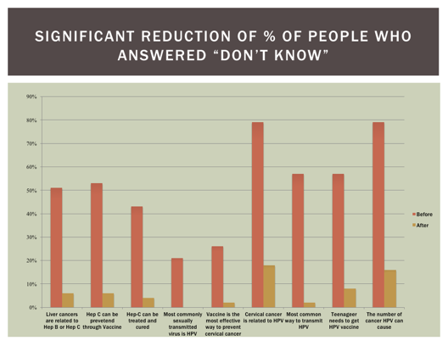
Programming in the Community: Example 1
  Prevent Cancer Foundation’s Think About the Link Campaign & New Tang Dynasty (NTD) Television

Slide 18
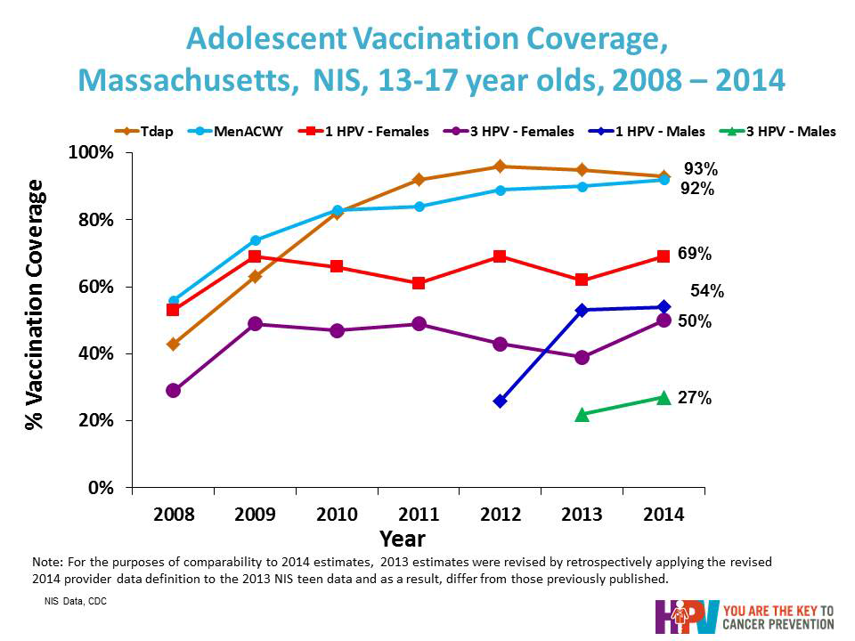
Programming in the Community: Example 2
  Team Maureen/Dana Farber Cancer Institute + Boston Public Health Commission

Slide 19

“Never doubt that a small group of thoughtful,
committed citizens can change the world;
indeed, it's the only thing that ever has."
Margaret Mead

