Slide 1
Lessons Learned from the Hepatitis C Cure Experience
Emalie Huriaux, MPH
Director of Hepatitis Policy, Project Inform
Chair, California Hepatitis Alliance

Slide 2
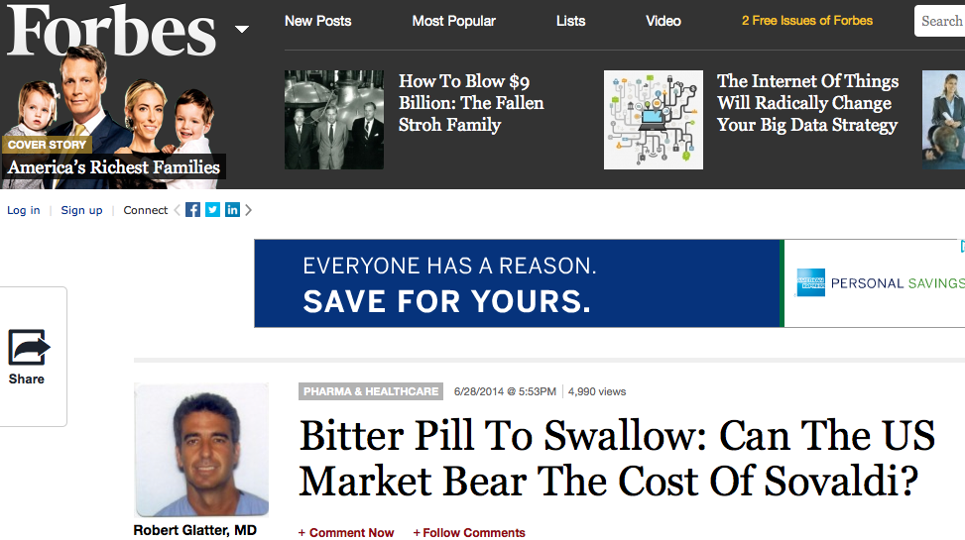
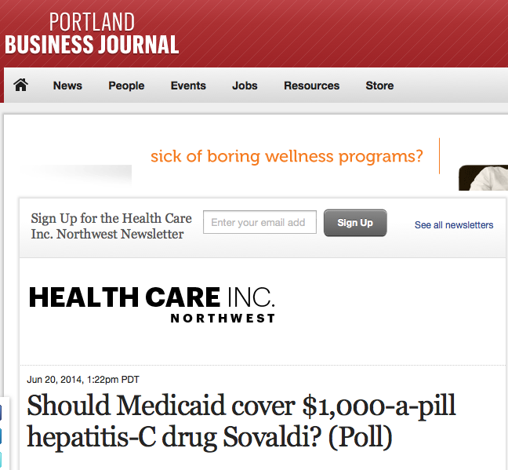
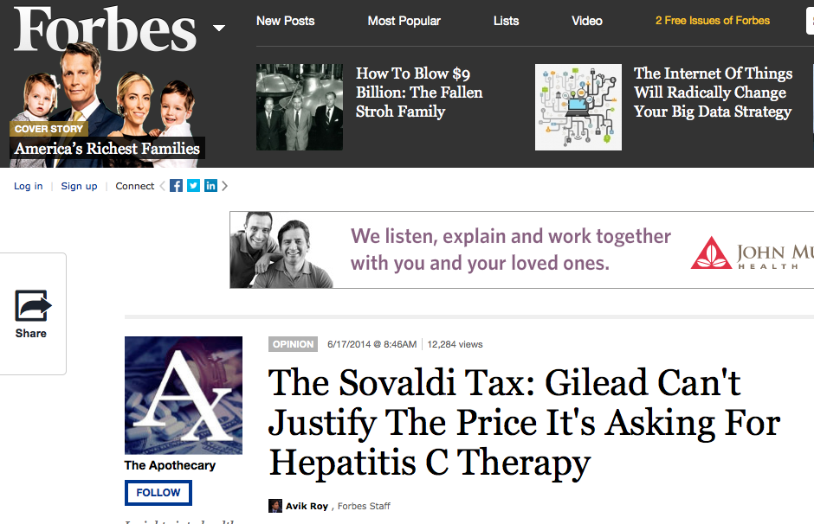
Notes:
There is a lot of “heat” on hep C treatment issues right now. The cost of new treatments is well publicized and very frightening to legislators, Medicaid directors, and other policy makers.

Slide 3
How the latest hep C meds were priced
Gilead’s drug Sovaldi (sofosbuvir) was the first in the new era of “direct acting antivirals” (DAAs) to treat & cure the hepatitis C virus (HCV).
The new DAA regimens are a game changer for people living w/ HCV.
New regimens cure over 90% of people with HCV, have few side effects, and are 8-24 weeks in duration (most commonly about 12 weeks).
Previous regimens, which included older class of DAAs, cured 50-70% of people, had many serious (sometimes debilitating) side effects, and had to be taken for 6-12 months).
The pricing of Sovaldi ($84,000 for 12 weeks of treatment) based on many factors, including perception of “value,” forecasting regarding upcoming competitor regimens, and comparison to the price of previous standard of care regimens.

Slide 4
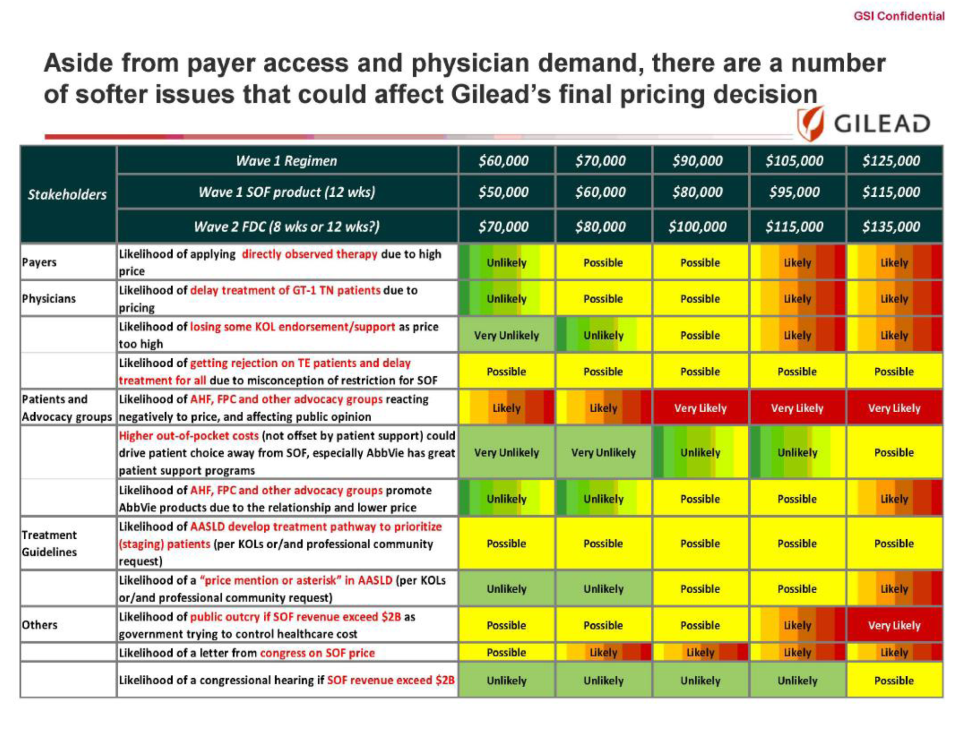

Slide 5
U.S. Senate Finance Committee Report on Pricing of Sovaldi
“The Gilead pricing team concluded that while pricing Sovaldi at $80,000 to $85,000 would generate an outcry from advocacy groups and payers, ‘[t]his price will allow Gilead to capture value for the product without going to a price where the combination of external factors and payer dynamics could hinder patient access to uncomfortable levels.’ Ultimately, Gilead was mistaken in some of its key assumptions as many public and private payers quickly reacted and adopted access restrictions.”
If you would like to read the full Senate Finance Committee report, visit: http://www.finance.senate.gov/imo/media/doc/3%20The%20Pricing%20of%20Sovaldi%20(Section%203).pdf

Slide 6
The Tension of Cost-Effectiveness vs. Affordability
Studies show that the DAAs are cost effective in the long term.
e.g., California Technology Assessment Forum states that at an average of $40k per cure, the new medications are “high value” to payers, including Medicaid programs.
Many payers/insurers have stated that purchasing DAAs is not affordable in the short term.
This is particularly true for public payers, like Medicaids & prisons, given their short-term budget cycles.
In response to the price, many payers/insurers have restricted DAA access.
Some of the reluctance of private insurers & some Medicaids to offer DAAs to patients with little or no fibrosis (e.g., F score of 0-1) is that any savings will likely accrue to a different payer (esp. as patients age into Medicare).
While some of these restrictions have lessened over time, restrictions based on disease progression and substance use still common.

Slide 7
Drug Purchasing Impacted by Complex Web of Health Systems & Financing
The “list price” is like the sticker price on a car – few payers actually purchase drugs at the “list price.”
Many public programs get automatic discounts and/or rebates (e.g., Medicaid, VA)
Many public payers, private insurers, and pharmacy benefit managers negotiate purchase prices with pharma. corporations.

Slide 8
https://www.nastad.org/sites/default/files/Getting_the_Best_Price_Final_2016.pdf

Slide 9
Purchase prices coming down (?)
The price for Sovaldi set a high baseline against which subsequent DAAs by Gilead and other pharmaceutical corporations were priced.
Once competition was present on the DAA market (with the approval of AbbVie’s drug Viekira Pak), Gilead announced to shareholders that it would provide 46% discounts on its drugs Sovaldi and Harvoni.
Subsequently, Merck’s DAA, Zepatier, came to market at $54,600 “list price”.
Rumors that some public payers are paying as little as $20,000 for 12 weeks of DAA treatment, but difficult to verify actual negotiated prices because these agreements are confidential and proprietary.

Slide 10
A group of community treatment activists advocating for fair & sustainable pricing of HIV & HCV drugs in the U.S. in order to support patient access. The FPC was formed in 1998 in response to exploitative pricing of HIV drug Retrovir.
The FPC:
Monitors & reports on price increases, organizing grassroots-driven media campaigns to prevent or fight against unfair drug pricing practices;
Educates our communities on the impact of drug pricing on treatment access;

Slide 11
The FPC also…
Requests that corporations meet w/ FPC prior to setting prices of newly approved drugs & before taking price increases, that their reps. w/ the proper authority to set pricing attend those meetings & that the companies alert FPC before price increases go into effect;
Negotiates w/ pharma corporations on the price of drugs, both in private insurance market, and for government programs such as AIDS Drug Assistance Programs (ADAP) & Medicaid;
Negotiates w/ companies to ensure that health insurance co-payments (co-pays) are not so excessive as to create a financial hardship or limit access to lifesaving treatment for people with HIV or HCV;
Negotiates w/companies to ensure that Patient Assistance Programs (PAPs) (which provide free medication to people w/ low incomes who do not qualify for govt. assistance) are adequately generous and easy to apply for.

Slide 12
Patient Access is Paramount
Payers/insurers vs. pharma. corporations = patients trapped in the middle
In addition to advocacy w/ pharma corporations re: prices, advocates around the country engaging w/ Medicaid programs & other payers/insurers to remove restrictions to HCV DAAs.
In CA, PI & CalHEP, along w/ clinicians, legal groups & other partners have met repeatedly with state officials & sent them community sign-on letters advocating for the removal of restrictions in Medi-Cal (CA’s Medicaid program) & ADAP.
While there are still some restrictions in Medi-Cal, many of the original restrictions put in place when Sovaldi was approved were removed in July 2015.
Since July 2015, there are no restrictions in the CA’s ADAP.

Slide 15
“Sticker Price” Impacts Patient Share of Cost
Drug formularies have “tiers,” generally broken down:
Low-cost generics
Higher-cost generics or preferred brand name drugs
Non-preferred brand-name drugs
“Speciality” (or high-cost) drugs*
*In many plans (including Covered CA plans), many HCV DAAs are tier 4.
Cost-sharing as high as 30%+ of “sticker price” in some plans, although CA is working to implement law that caps co-pays. Starting this year, Covered CA plans implemented co-pay caps, with the cap generally being no more than $250 per drug per month.
Co-pays can impact patient access. Numerous studies show that when patients cannot afford co-pays they skip doses, split pills, or don’t fill/refill prescriptions.

Slide 16
When there is a “functional cure” or cure for hep B, how will it be priced?
This is unpredictable, but we might look to the price of the current HBV standard of care. Most current regimens have list prices between $450-$1300 for 30 days of treatment, but keep in mind that the actual negotiated purchase prices are lower.
Viread, for example, has a list price of $997.77. The Federal Register price that the VA and DoJ pays is $350-$400 lower, which back calculates to an average price in the market of about $750.
Price will depend on duration of therapy – will HBV treatment be lifetime or short-duration treatment?
CDC estimates that the lifetime treatment cost for HIV is $379,668 (in 2010 dollars)
Notes:
30 day unless noted
BARACLUDE tablets: 0.5 mg or 1 mg, $1294.79
VIREAD tablets: 150 mg, 200 mg, 250 mg, $924.71
VIREAD tablets: 300 mg, $997.77
EPIVIR‑HBV tablets 100 mg $895.97 (60 tabs)
HEPSERA tablets 10 mg $1238.24
TYZEKA tablets 600 mg $1071.05

Slide 17
Implications for Hep B Advocates
Develop calculations regarding the cost implications of a hypothetical cure or functional cure. For example:
What are the lifelong treatment costs with the current HBV treatments?
With new treatments, how many liver transplants avoided? How many hospitalizations avoided?
The first drug out of the gate will likely set the tone for pricing of subsequent regimens. Engage w/ pharma corporations with promising HBV cures/functional cures early & emphasize impact of pricing on patient access.
Monitor public & private payers/insurers to ensure patients do not experience barriers to access.
Work with media to emphasize patient stories & the importance of drug access and to shed light on pharma corporation and/or payer behaviors that negatively impact access.

Slide 18
Building a Movement to Cure All*
*Thanks to Daniel Raymond at Harm Reduction Coalition for coming up with this phrase

Slide 19
Contact Information
Emalie Huriaux
Director of Federal & State Affairs, Project Inform
Co-Chair, California Hepatitis Alliance
(415) 580-7301
ehuriaux@projectinform.org

