Slide 1
HCV and history of the Cure SF HBV Free 2016
Robert G Gish MD
Professor Consultant
Stanford University

Slide 2
‘Hepatitis’ means inflammation of the liver
The liver is a vital organ that processes nutrients, filters the blood, and fights infections
When the liver is inflamed or damaged, its function can be affected and can lead to acute liver failure, cirrhosis, liver transplant, liver cancer and death

Slide 3
“Hepatitis” is most often caused by a virus Such as HBV and HCV and deaths due to viral hepatitis exceed those due to AIDS in the US and WorldWide
Other causes of liver inflammation include hepatitis A, E and D as well as heavy alcohol use, fatty liver, rare genetic liver conditions, toxins, autoimmune diseases and some medications, as well as some medical conditions

Slide 4
HCV is nearly 4 times as prevalent as HIV and HBV
Prevalence of Chronic Viral Infections
5 Million¹ 75% Unaware of Infection
5
4
~2.2 Million¹ 65% Unaware of Infection
Total No. Infected (millions)
2
1.1 Million¹ 21% Unaware of Infection
1
Undiagnosed
Diagnosed
0
HIV
HBV
HCV
A 2011 study estimated that as many as 5.2 million persons are living with HCV in the United States²
HBV=hepatitis B virus; HCV=hepatitis C virus; HIV=human immunodeficiency virus.
Gish Hepatology 2015.
Chak E, et al. Liver Int. 2011;31(8):1090-1101.

Slide 5
Fibrosis Progresses Over Time with Chronic HCV infection
End Stage Liver Disease
About 20-30 years
Fibrosis
“liver damage”
Normal Liver
Cirrhosis
HCC
Stable Disease
Cure reduces but does not eliminate the risk of liver failure and hepatocellular carcinoma

Slide 6
Preparing for HCV Therapy
Screen
HCV Ab
Confirm Infection
& Genotype
Stage
Fibrosis
Treat?
With What?
Relevant
History and
Physical
Assess
Compliance
HCV Evaluation and Staging
-Treatment history (interferon therapy or DAA)
-Genotype (1, 2, 3..) and subgenotype (1a vs 1b).
-Imaging
-Required testing by insurance
-Viral load (copies/mL)
-Fibrosis score (i.e. Fib-4)
-Fibroscan or biopsy
-Drug-drug interactions (DDIs)

Slide 7
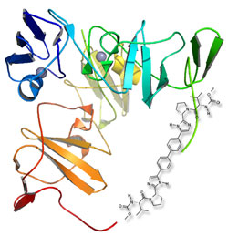
The HCV Molecular Locksmith
HCV viral proteins are disabled with DAAs
but they must fit specifically: Like a Lock and Key

Slide 8
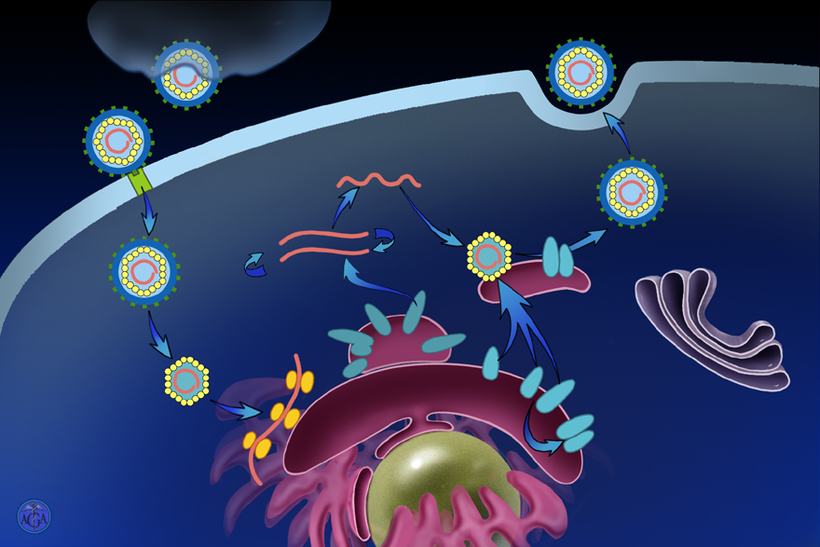
Hepatitis C Virus: Viral Replication,
Hepatitis C Virus - Replication
Lipoproteins
Export
Progeny genome
Entry
Replication
Assembly
+
E1-E2
NS5B
NS4B
Golgi
NS3/4A
NS5A
ER
C
NS2
E1
Uncoating
E2
Chaperones
ER
E1-E2
Translation
Nucleus
Notes:
Slide 31 - part 4

Slide 9
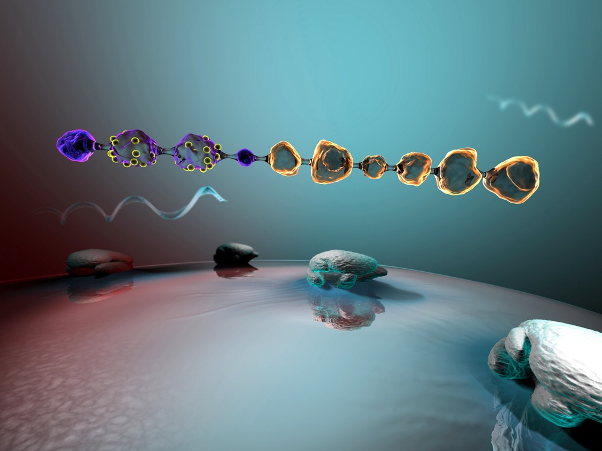
HCV Genome
C
E1
E2
p7
NS2
NS3
NS4A
NS4B
NS5A
NS5B
ARFPs
Kwong A, et al. Beyond interferon and ribavirin: Antiviral therapies for hepatitis C virus.
Drug Discovery Today: Therapeutic Strategies. 2006;3:211-220.

Slide 10
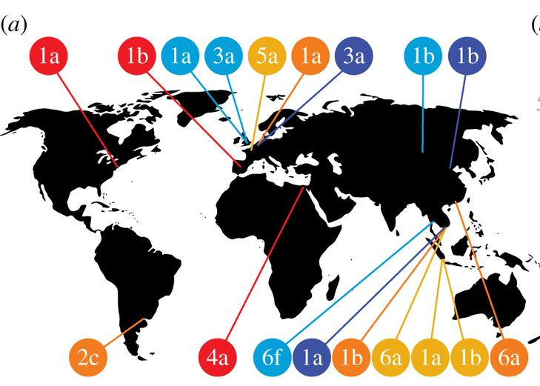
HCV Genotype 1: Most common in US where research was focused
Global
United States
2/3 genotype 1a
1/3 genotype 1b
Trans R Soc B 368: 20120314.

Slide 11
HCV DAA nomenclature
DAA= Direct-acting Antivirals
HCV Protease Inhibitors: ending in previr
e.g. Paritaprevir
HCV NS5A Inhibitors: ending in asvir
e.g. Ledipasvir
HCV Polymerase Inhibitors: ending in buvir
e.g. Sofosbuvir or Dasabuvir
Includes nucleotide/non-nucleoside analogs

Slide 12
Principles of All-oral Regimens for HCV
No interferon
Combine drugs from different classes
Hit multiple viral targets to increase efficacy
Diminishes risk of viral resistance
Benefits of multi-drug strategies
Backbone/anchor drug plus additional agent(s)
Superior efficacy than expected from individual drugs
Excellent outcomes
Near universal efficacy
Short duration of therapy
Side effects have minimal impact on quality of life and are indistinguishable from placebo
Notes:
Backbone compound:
High barrier to resistance does much of the heavy lifting

Slide 13
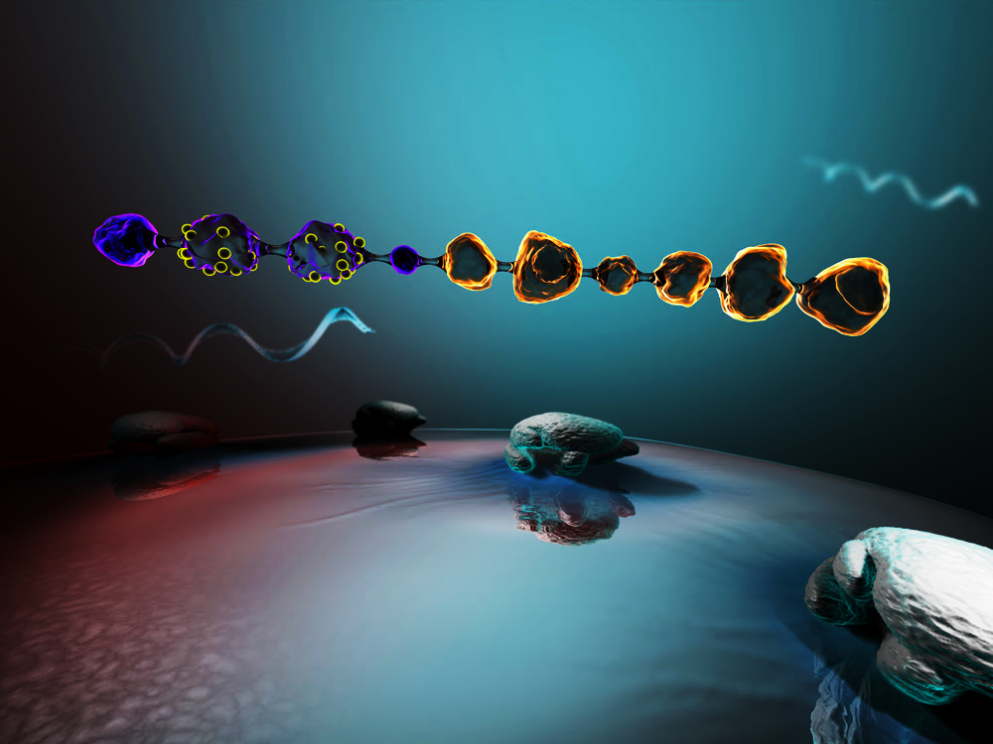
HCV Drug Targets
NS3
NS4A
NS5A
NS5B
Target | Potency | Barrier to Resistance | Genotypic Coverage
NS3/4A | High | Low | Limited
NS5A | High | Intermediate | Multi
NS5B NUC | Intermediate | High | Pan-genotypic
NS5B Non-NUC | Intermediate | Low | Limited

Slide 14
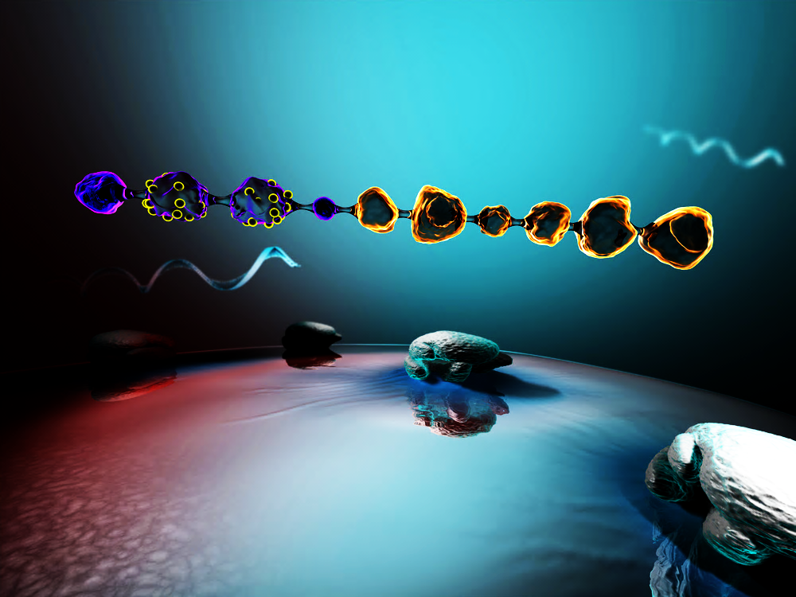
HCV Novel FDA Approved DAAs
NS3
NS4A
NS5A
NS5B
NS3/4A Protease inhibitors
Simeprevir (COSMOS)
Paritaprevir (Viekira)
Elbasvir (Zepatier)
NS5B Nucleos(t)ide inhibitors (NI)
Sofosbuvir (COSMOS, Harvoni, or Eplcusa)
NS5A Inhibitors
Ledipasvir (Harvoni)
Ombitasvir (Viekira)
Daclatasvir (Daklinza)
Elbasvir (Zepatier)
Velpatasvir (Epclusa)
NS5B Non-nucleoside inhibitors (NNI)
Dasabuvir-DSV (Viekira)

Slide 15
FDA Approved HCV Regimens Vary by Genotype
Genotype 1:
Sofosbuvir/Simeprevir
Sofosbuvir/Ledipasvir
Paritaprevir/r, Ombitasvir, Dasabuvir +/- Ribavirin (RBV)
Elbasvir/Grazoprevir
Sofosbuvir/Velpatasvir
Genotype 2:
Sofosbuvir/RBV
Sofosbuvir/Velpatasvir
Genotype 3:
Sofosbuvir/RBV
Sofosbuvir/Daclatasvir* (±RBV)
Sofosbuvir/Velpatasvir
Genotype 4 similar to GT 1
Genotype 5/6
Sofosbuvir/Velpatasvir
Sofosbuvir/Ledipasvir
*Sofosbuvir and Daclatasvir is a pan-genotypic combination.

Slide 16
HCV Cure: Sustained Virologic Response (SVR)
Early indicator of success @ 4 weeks: HCV RNA negative
Bad sign: viral breakthrough, late TND or relapse after treatment.
Durable CURE: Known as Sustained Virologic Response (SVR).
Determined 12 weeks after treatment (SVR 12).
Patients are CURED! But can be infected if exposed again

