Slide 1

Hep B United: Building a National Voice to Address Hepatitis B
Kate Moraras
SF Hep B Free 2nd Annual Viral Hepatitis Summit
October19, 2016

Slide 2


The Growing Momentum to Address Hepatitis in the U.S.
2010 – Landmark Institute of Medicine Report
2011 - HHS Combating the Silent Epidemic of Viral Hepatitis: Action Plan for the Prevention, Care and Treatment of Viral Hepatitis
2012 – Hepatitis B Foundation & Association of Asian Pacific Community Health Organizations (AAPCHO) developed Hep B United with the help of the HHS Office of Minority Health.
  Purpose: Elevating the profile of hepatitis B
Notes:
A landmark report published by the Institute of Medicine (IOM) in January 2010 recommended new policy, legislative, community and medical efforts to confront and control viral hepatitis and liver cancer.
In May 2011, the U.S. Department of Health and Human Services released Combating the Silent Epidemic of Viral Hepatitis, a Viral Hepatitis Action Plan (VHAP) based on these recommendations, with a focus on addressing hepatitis B among Asian Americans and Pacific Islanders.

Slide 3
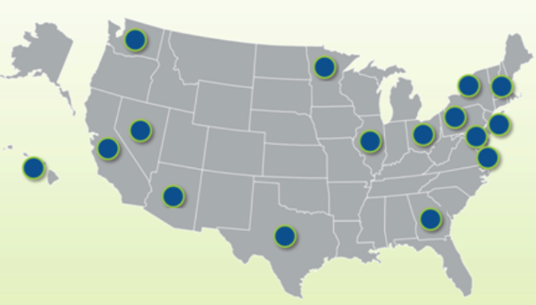

Hep B United Background
30+ local coalitions & natl. organizations that focus on the Asian American, Native Hawaiian & Pacific Islander (AA&NHPI) communities.
Support and leverage successes of coalitions to:
  Increase hepatitis B awareness, screening, vaccination, and linkage-to-care for all Americans, but with a special focus on AA&NHOPIs, who face disproportionate infection rates

Slide 4
Goals of Hep B United
Raise the profile of hepatitis B and liver cancer as an urgent public health issue.
Increase hepatitis B testing and vaccination, particularly among AA&NHOPI communities at higher risk.
Improve access to care and treatment for individuals living with hepatitis B to prevent end-stage liver disease and liver cancer.

Slide 5
“Coalition of Coalitions”
CBOs/FBOs
Hep B Coalitions
Academic/Research Institution
Community Health Clinic/FQHCs
Student Organization
Business Community
Local/State Health Department

Slide 6
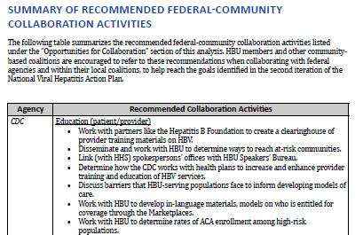
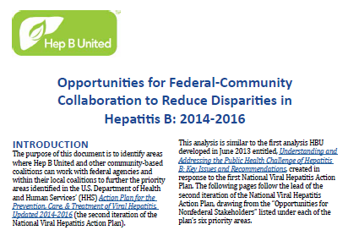
A Hepatitis B Community Platform
Educating Providers and Communities to Reduce Health Disparities
Improving Testing and Linkage to Care to Prevent Hepatitis B-related Liver Disease and Cancer
Eliminate Perinatal Transmission
Strengthen Surveillance to Detect Viral Hepatitis Transmission and Disease
Hep B Community Strategic Plan
Response to HHS VHAP: Opportunities for Federal-Community Collaboration
Notes:
In August 2012, Hep B United convened a summit with its member coalitions and developed a draft strategic plan in response to the HHS action plan, and created a roadmap to address and mobilize efforts to combat hepatitis B at the community level.

Slide 7

Coalition Building – HBU & CDC Partnership
Education and Training
Improve ability to manage, grow and sustain local coalitions
Capacity Development
Conduct/evaluate community-based HBV screening using best practices; collect, manage and share HBV-related data
Peer-to-Peer Mentoring
Conference Calls
Mini-Grants
Webinars, Video Chats
In-Person Summits
Toolkits
Speakers Bureau
Resource Dissemination
Enhance usage of linguistically and culturally competent materials, primarily those within the Know Hepatitis B campaign
Technical Assistance
Improve social media and overall communications presence
Education and Training
Improve ability to manage, grow and sustain local coalitions
Education and Training
Improve ability to manage, grow and sustain local coalitions
Capacity Development
Conduct/evaluate community-based HBV screening using best practices; collect, manage and share HBV-related data
Capacity Development
Conduct/evaluate community-based HBV screening using best practices; collect, manage and share HBV-related data
Peer-to-Peer Mentoring
Conference Calls
Mini-Grants
Webinars, Video Chats
In-Person Summits
Toolkits
Peer-to-Peer Mentoring
Conference Calls
Mini-Grants
Webinars, Video Chats
In-Person Summits
Toolkits
Resource Dissemination
Enhance usage of linguistically and culturally competent materials, primarily those within the Know Hepatitis B campaign
Resource Dissemination
Enhance usage of linguistically and culturally competent materials, primarily those within the Know Hepatitis B campaign
Technical Assistance
Improve social media and overall technology usage
Technical Assistance
Improve social media and overall technology usage
Notes:
What makes Hep B United unique and sets it apart from how coalitions have traditionally been formed is that the focus has been on fostering hepatitis b interventions/developing programs in addition to policy advocacy. This chart highlights the focal areas around coalition capacity building:
Education and Training – media training, advocacy training, coalition building and topical areas like GIS mapping and data collection and IRB.
Capacity Development – mini grants directed towards education and screening.
Resource Dissemination – Know Hep B
Technical assistance – Creating an online communications presence and Speakers Bureau

Slide 8
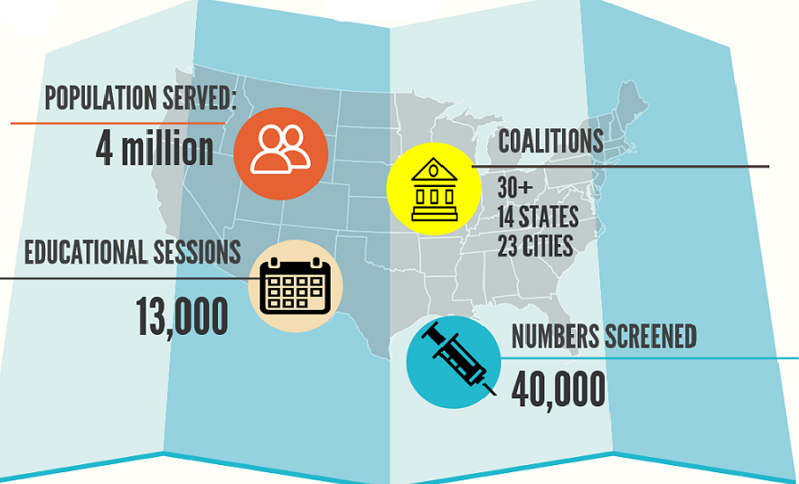
Reach of HBU Coalition Partners

Slide 9




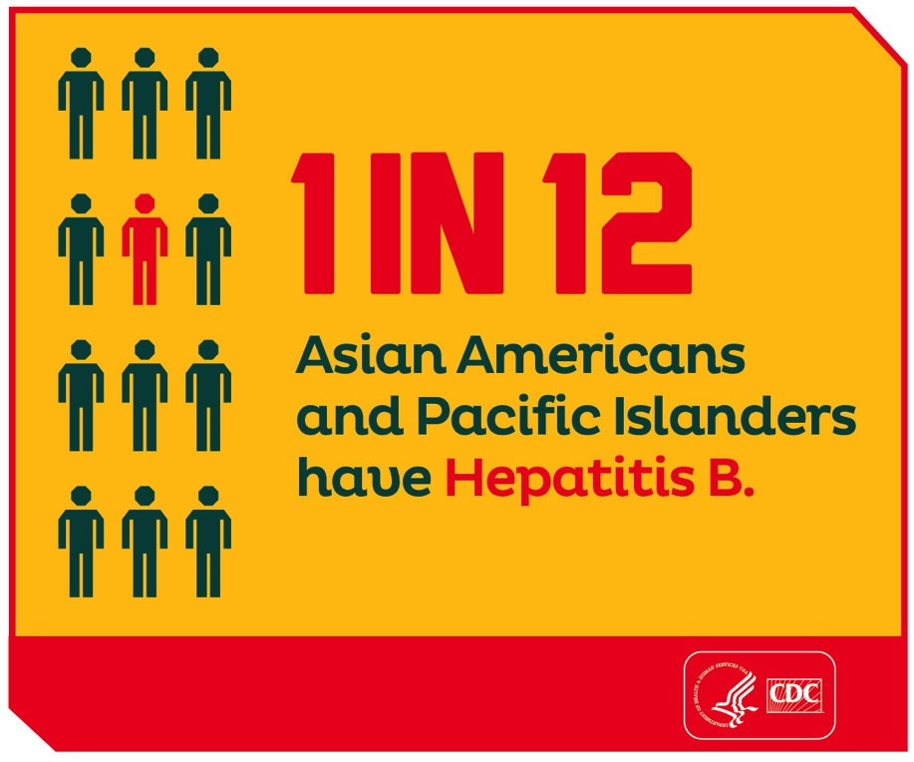



Slide 10

Online Trainings
Best Practices in Community-Based HBV Screening
HBV Healthcare Provider Knowledge & Screening Practices
Get to Know Hepatitis B: the KHB Campaign
National Strategies to Combat Viral Hepatitis
Building & Maintaining HBV Community Coalitions
HBV Data Collection & Management
Reducing Perinatal HBV Transmission
Using Ethnic Media to Increase HBV Awareness & Education

Slide 11
HBU Peer-to-Peer Mentoring
Foster relationships among community coalition partners with national and federal partners, improve skills, and enhance the sharing of best practices across the HBU coalition
Site Visits & Strategic Planning (9-12 months)
2014 Matches:
  HBU Philadelphia & New Jersey Hepatitis B Coalition
  HBI-DC & Hep B United Twin Cities

Slide 12
HBU Mini-Grants Program
$ 75K - $80K annually in seed funding to 8-10 organizations
Enhance the capacity of HBU coalition partners to conduct HBV education, testing and linkage to care with projects focused on:
  Outreach and screening new AAPI communities
  Local Coalition Building and Sustainment
  Awareness/Media Engagement
  HBV Data Management
  Youth Engagement

Slide 13
Hepatitis B Advocacy
Prioritizing Hepatitis B and Developing a Grassroots Movement

Slide 14





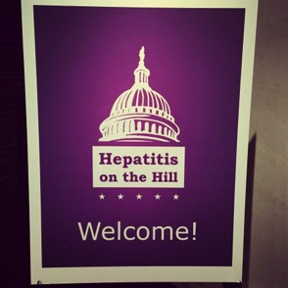
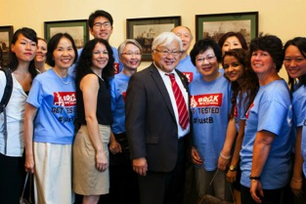
National Advocacy Coalition Collaborations
Congressional Viral Hepatitis Testing Days
Congressional Hepatitis Briefings
White House World Hepatitis Day Observance
Hepatitis on the Hill (HAP, HBU, NVHR)
HBU Summit & Advocacy Day

Slide 15
Hepatitis B Policy Priorities
Advocate for increased prioritization of hepatitis B at the federal and state levels
Increase access to hepatitis B screening and care (implement USPSTF HBV screening guidelines) Prioritize the goal to eliminate perinatal HBV transmission Increase federal funding for hepatitis B research, screening, vaccination, and linkage to care programs and liver cancer research Increase adult HBV vaccinations Strengthen surveillance to monitor chronic hepatitis B Address and decrease HBV-related discrimination

Slide 16
Hepatitis B Storytelling
HBF collaboration with StoryCenter on a digital storytelling project -- make the real voices of every-day people living with/affected by hepatitis B a key ingredient of our prevention and advocacy efforts
4-Day Digital Storytelling Workshop (Jan 2017) to share stories, build relationships, identify strategies for publicly sharing stories
Raise awareness, reduce stigma/discrimination, and develop hepatitis B champions!

Slide 17
Become a Hep B Advocate
Develop a grassroots HBV movement
Identify community champions
Identify Congressional champions
Determine opportunities for national advocacy campaigns
Build partnerships with allied groups & coalitions (intersections of hepatitis B/liver cancer)

Slide 18




Connect with Us! HepBUnited.org

Slide 19

Thank you!
Kate Moraras
Director, Hep B United
E-mail: kate.moraras@hepb.org
www.hepb.org
www.hepbunited.org

