Slide 1
Preparing for an HBV Cure Lessons learned from HCV
Annie Luetkemeyer, MD
HIV, ID and Global Medicine
2nd Annual Viral Hepatitis Summit

Slide 2
Key differences between HBV & HCV
 | HBV | HCV
Latent virus | Yes- cccDNA | No
Cure attained in nature | No- immune control but residual cccDNA which can reactivate | Yes- spontaneous clearance in ~ 20%
Effective Vaccine | Yes | No
Prophylaxis to prevent transmission | Yes (peri-natal) | No
Suppressive Therapy | Yes | ---
Curative therapy | No (yet) | Yes

Slide 3
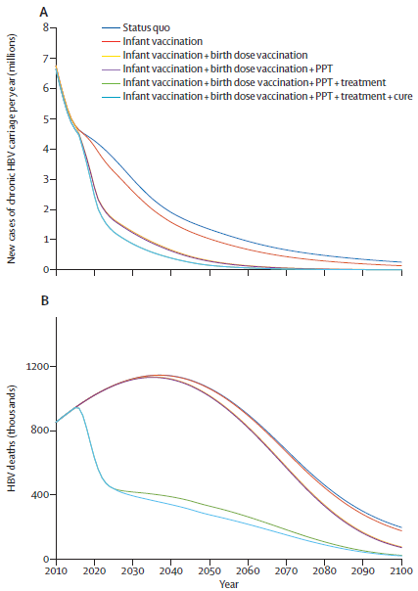
Role of Cure in Viral Hepatitis Elimination Toolbox
HCV Elimination:
Diagnosis
Curative treatment
Prevention of infection & reinfection
HBV elimination:
Diagnosis
Vaccination
Peri-partum treatment
Suppressive therapy
Cure
Reduce morbidity & mortality in adults already HBV infected
Nayagam Lancet ID 2016

Slide 4
Nayagam Lancet ID2016

Slide 5
What do we mean by cure?
HCV: Sterilizing cure- if no HCV RNA detected in the body 12-24 weeks after treatment, HCV has been eradicated).
HBV
Sterilizing cure: NO HBV virus in the body (including cccDNA), thus no potential for reactivation
“Functional cure”: finite treatment leading to immunologic control such as seen with resolved natural infection (sAg loss, +/- gain of HBsAb), cccDNA persists
? Risk for reactivation

Slide 6
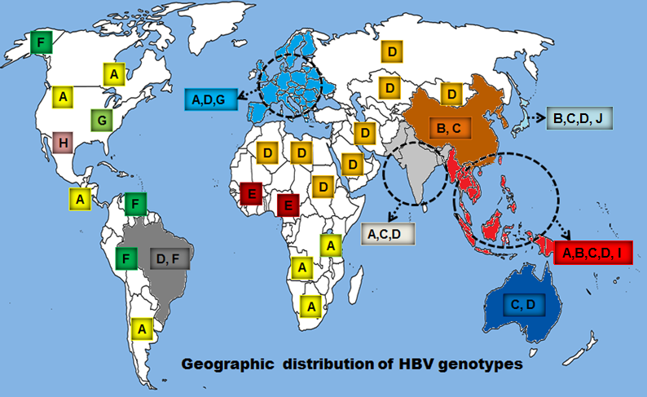
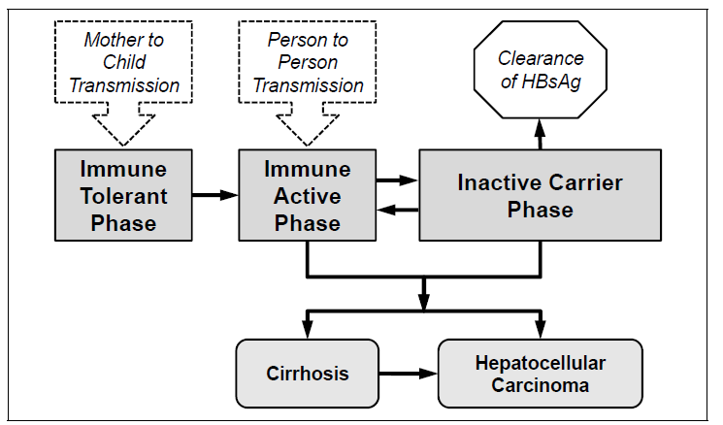
When one size does not fit all
HCV: Evolving from genotype specific to pangenotypic treatments
HBV: Type of cure will impact access & implementation
Genotype specific?
E Antigen + specific?
Requires immune active phase? activitnb

Slide 7
Who benefits from treatment
HCV: took years for science to support universal treatment, with benefit recognized across the range of fibrosis
Access to HCV medications still lags behind the science supporting universal treatment
“Evidence clearly supports treatment in all HCV-infected persons except those with limited life expectancy (less than 12 months) due to non liver related comorbid conditions”
www.hcvguidelines.org

Slide 8
Who benefits from HBV cure?
Difficult question to answer as currently there is no sterilizing cure (apparently even in nature!)
Treatment guidelines based on current suboptimal treatment
Nucleosides: DNA suppression, but very low rates of immune control , thus indefinite treatment
PEG-IFN: better but still low sAg loss, seroconversion. Poorly tolerated.
Current Goal: reduce risk of cirrhosis and HCC while balancing downsides of PEG-IFN or indefinite oral therapy.

Slide 9
Current HBV treatment guidelines
Population
Compensated cirrhotics | HBV DNA > 2000 IU
Decompensated cirrhotics | Any detectable DNA
Immune Active (E Ag Positive or Negative) | HBV DNA > 2000 IU, AST > 2x ULN (DNA threshold varies by guideline)
Immune Tolerant | < 30 years old : Generally don’t treat > 30 years old: consider biopsy and possible treat Ongoing controversy: treatment to reduce risk of HCC associated with high HBV viral load
Inactive Carriers | Treatment not recommend

Slide 10
How to prioritize with HBV cure
Population
Compensated cirrhotics | High priority
Decompensated cirrhotics
Immune Active (E Ag Positive or Negative) | High Priority
Immune Tolerant
Inactive Carriers

Slide 11
How to prioritize with HBV cure
Population
Compensated cirrhotics | High priority
Decompensated cirrhotics
Immune Active (E Ag Positive or Negative) | High Priority
Immune Tolerant | Higher priority group if treatments are not immune mediated- can reduce fibrosis and cancer risk before immune active Greatly increases # to treat
Inactive Carriers

Slide 12
How to prioritize with HBV cure
Population
Compensated cirrhotics | High priority
Decompensated cirrhotics
Immune Active (E Ag Positive or Negative) | High Priority
Immune Tolerant | Higher priority group if treatments are not immune mediated- can reduce fibrosis and cancer risk before immune active Greatly increases # to treat
Inactive Carriers | Will need to understand benefit in this group

Slide 13
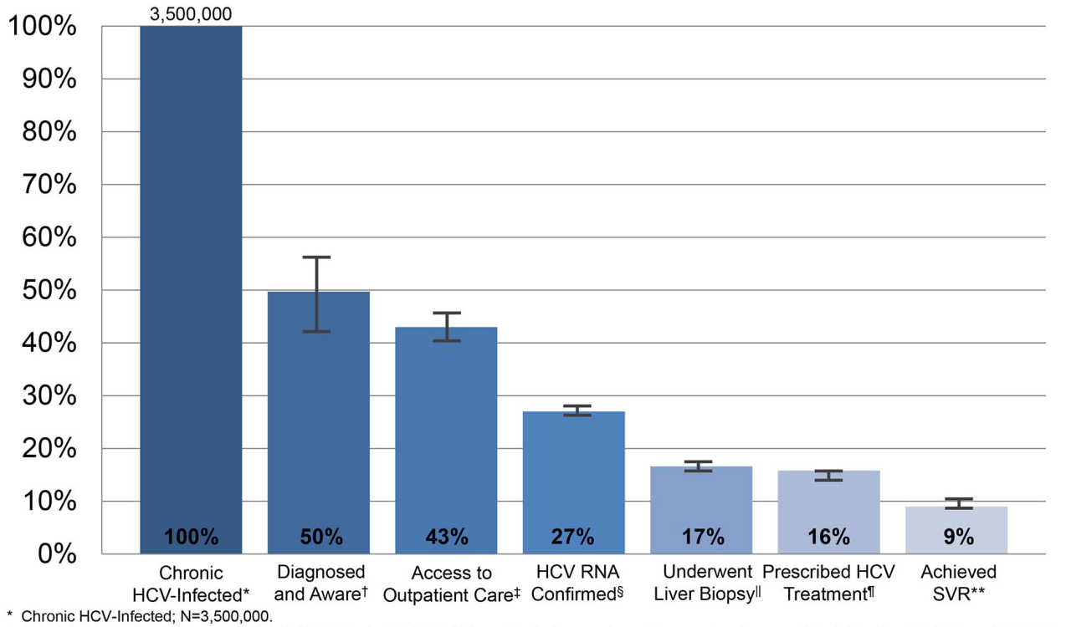
We can’t cure people we don’t know are infected!
Enormous barrier to HCV treatment
Similar challenges with HBV, both in the US and to a far larger degree globally
Availability of effective treatment changes the priority for widespread diagnosis

Slide 14
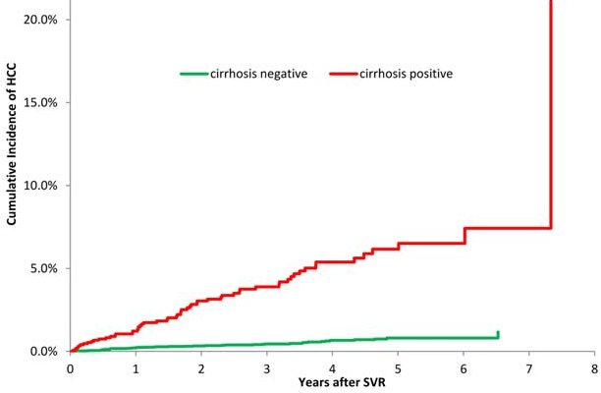
After the cure: HCC Risk
HCV associated with HCC generally only in setting of advanced fibrosis/cirrhosis
Fibrosis can improve but HCC risk still elevated
Crisslen AASLD 2015 #108, El Serag Hepatology 2016:64(1); 130

Slide 15
HCC risk after HBV cure
HBV associated with HCC even in absence of cirrhosis
Even with sterilizing cure (ie, no cccDNA), may have persistent cancer risk due to integrated HBV DNA in host genome
Will need to remain vigilant about HCC risk and understand who needs ongoing screening

Slide 16
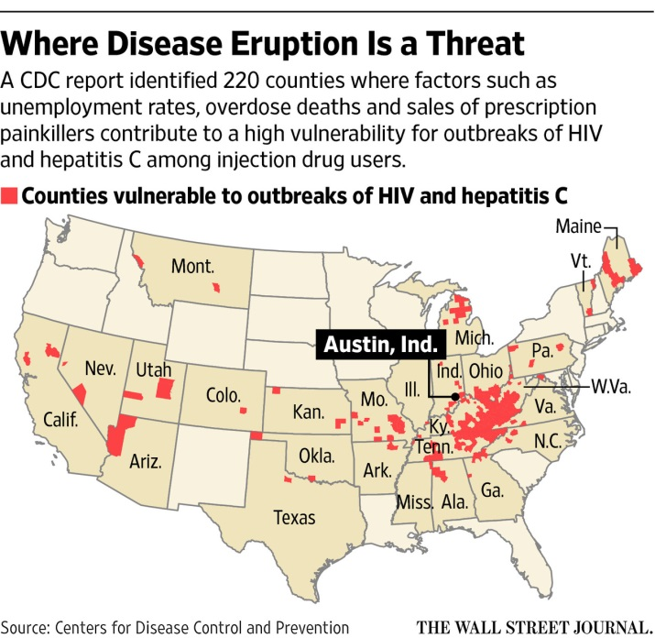
After the Cure:Reinfection
Critical consideration in HCV elimination efforts
HIV+ MSM with reinfection rates as high at 25%
Ongoing HCV transmission associated with IDU in settings w/o safe injecting equipment
Reinfection in HBV?
Unlike HCV, HBV antibodies are protective and we have effective vaccine
Will sterilizing cure be associated with durable immunity ? Or will those cured be at risk of HBV reinfection? Role of vaccination
Likely more of a concern with HCV than HBV
Inglitz Hepatology 2016, Simmonds CID 2016

Slide 17
Much to learn from the HCV cure
Many unknowns with HBV which is biologically distinct from HCV and “cure” may look quite different & play a different role in disease control.
Must ramp up HBV diagnosis worldwide
HBV cure will likely be expensive, particularly in the beginning
Enormous numbers to treat worldwide, with challenging questions about whom to prioritize
Remarkable opportunity to reduce HBV related disease and death, by using the many tools we have to combat HBV, including HBV cure

