Slide 1
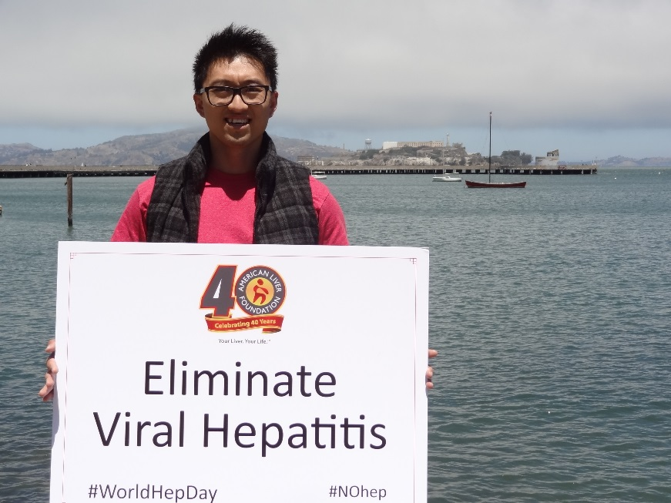
Lynn Gardiner Seim, MSN, RN Executive VP/Chief Operating Officer American Liver Foundation
October 19, 2016

Slide 2
ALF’s mission is to facilitate, advocate, and promote education, support, and research for the prevention, treatment and cure of liver disease
Notes:
I would like to start my presentation by talking about our mission.
Because mission is where everything begins.
It is why we have fundraising events – flavors, galas, walks, challenges and make a difference events.
As most of your know – ALF’s mission is to facilitate, advocate, and promote education, support, and research for the prevention, treatment and cure of liver disease.
Yes. The mission is a little wordy. But I would like to add a few words to it. Words like “patients” “families” and “people.”

Slide 3
Four Cornerstones of ALF Mission Delivery
Education
Advocacy
Support
Research

Slide 4
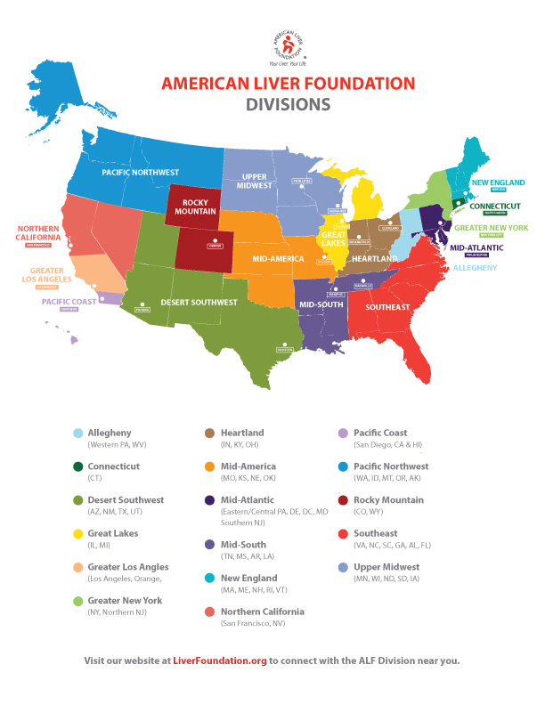
Notes:
But, it is time for the American Liver Foundation to go from good to great.

Slide 5
Education
National Webinars
Hepatitis C: Treatment Options and the Patient Experience
Accessing and Managing Hepatitis C Treatment: Benefits of Working with a Specialty Pharmacy
Upcoming: Hepatitis C and Kidney Disease

Slide 6
Education
Community Education Programs
Love your Liver
Teens to Twenties Liver Wellness Guide
Liver Wellness
Viral Hepatitis – Over 5,000 were reached through our Viral Hepatitis Program last year (37% of total people reached)
Prisons, probation/parole facilities
Substance treatment programs
GLBT centers and other at-risk youth
Regional Programs - Often with Viral Hepatitis Themes
Patient Education
Ask the Experts
Liver Updates
Professional Education
Academic Debates
Medical Advisory Committee / Associate Medical Advisory Committee
Symposia

Slide 7
Education
Examples of Regional Programs
Greater New York Division
Ask the Experts: HCV/HIV Coinfection in the Latino Community
Partnered with Latino Commission on AIDS
Attendees included patients as well as professionals from Hispanic Federation of Nurses, Harlem United, and AIDS Healthcare Foundation
Great Lakes Division
HCV Education and Screening Initiative
Collaboration with MADE (Making A Daily Effort) and BHC (Brothers Health Collective)
Hard-to-access populations for HCV screening and linkage to care
So far over 5,500 screened
New England Division
Drug and Alcohol Treatment Centers
Relationships with 32 different treatment programs throughout New England
Education and linkage to care

Slide 8
Viral Hepatitis Related Resources
Education

Slide 9
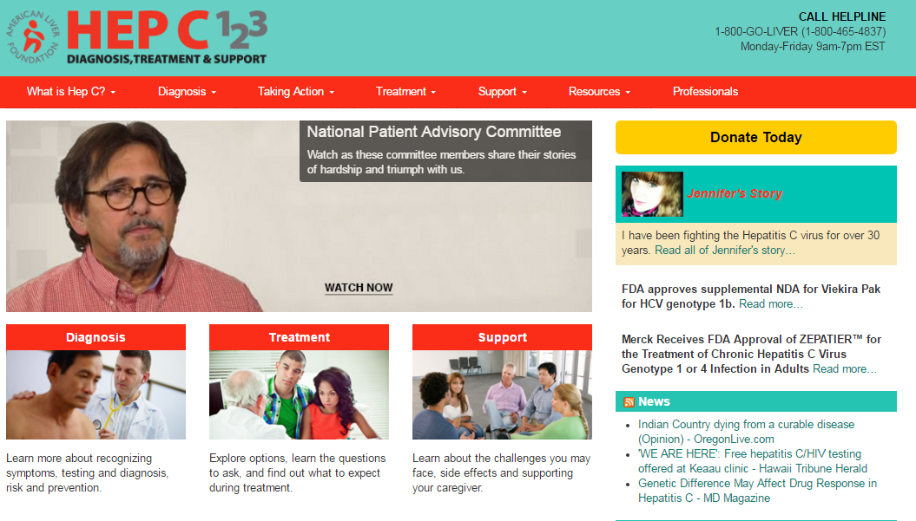
Web Presence
Education
National
Liverfoundation.org
1.2 million unique visitors in FY 2015
8,082 unique visits to Hep B page
HepC123.org
529,000 visits in FY 2015
Social Media
Facebook – 114,000+ fans
Twitter – 4,900+ followers
Growing following on: Instagram, LinkedIn, Pinterest, YouTube and Google+

Slide 10
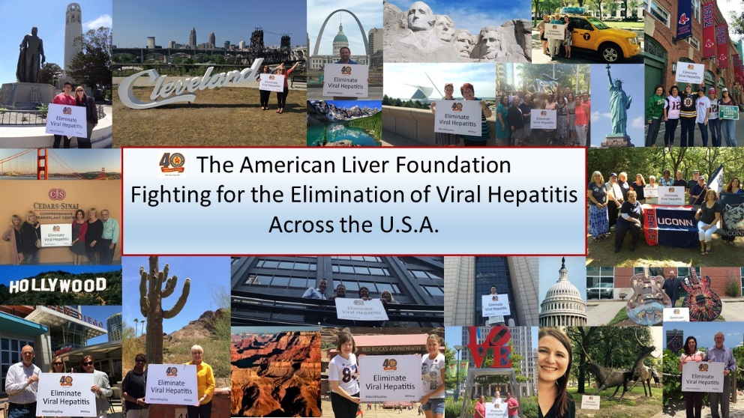
Social Media
Education
Example: Hepatitis Awareness Month, May 2016
Tweet Chat on Hepatitis C
Created Call to Action and Social Media toolkit for Hepatitis Awareness Month; distributed to advocates, placed on website, and posted to online support groups
27 Hepatitis Awareness Month related posts on FB reached 210,000 with over 12,700 engagements (clicks, likes, shares, comments)
Significant activity on Twitter and LinkedIn
Example: World Hepatitis Day July 28, 2016
Divisions across the country took photos in front of famous landmarks as part of our Eliminate Hepatitis campaign shared across all social media platforms

Slide 11
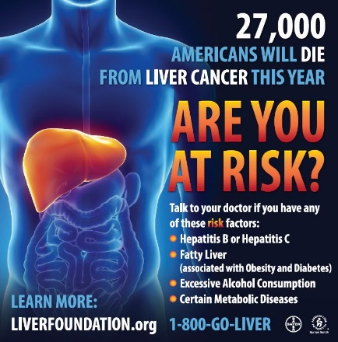
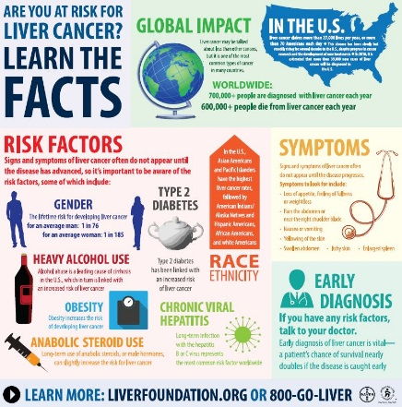
Liver Cancer Awareness Campaign
Education
“Are You At Risk” messaging focuses on major risk factors for liver cancer, including viral hepatitis, reaches millions through various outlets annually
Transit ads, billboards, movie theatre PSA, comprehensive social media messaging, traditional media outreach, satellite media tour, liver cancer programs in ALF divisions
Anecdote: NYC subway worker saw campaign and was prompted to call. Didn’t know his HCV put him at risk for liver cancer

Slide 12
Support Services
National HelpLine 1–800-GO-LIVER (1-800-465-4837)
FY 2015 Inquiries – 5,976 (calls, emails and letters)
Disease specific information
Physician locator
Financial resources
Multi-language capability
52.5% of inquiries related to HCV
3.5% of inquiries related to HBV
HelpLine Top Five:
Hepatitis C (HCV) – 52.53%
Liver Cancer – 10.15%
NAFLD – 9.19%
Alcohol-Related Liver Disease – 5.21%
Primary Biliary Cholangitis – 3.69%

Slide 13
Support Services
Online Support Community
Collaboration with Inspire
Almost 11,000 individuals enrolled
Approximately 30% specifically interested in viral hepatitis
Over 2,000 threads pertaining to viral hepatitis

Slide 14
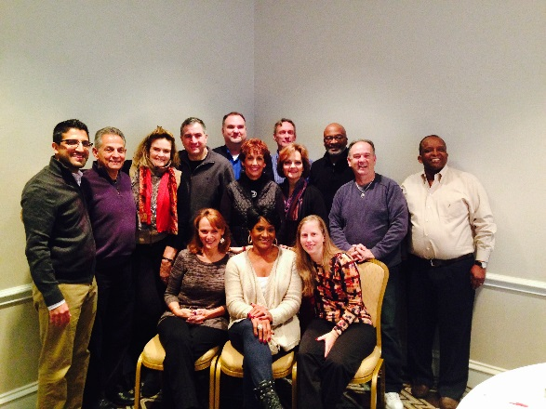
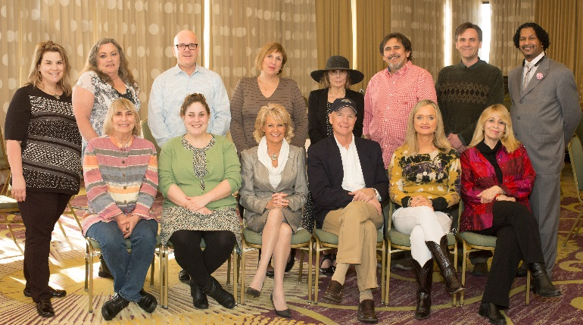
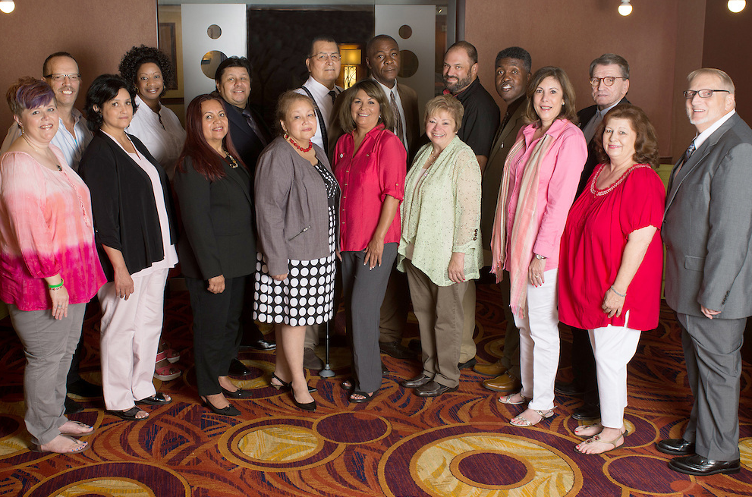
Advocacy
National Patient Advisory Committee (NPAC)
Social Media Champions
Go-to advocates for advocacy and media opportunities
Veterans Day Radio Media Tour reached millions
Patient Education Videos

Slide 15
Advocacy
2016 Legislative Priorities Included:
$34.5 billion for the National Institutes of Health (NIH) and $2.165 billion for the National Institute of Diabetes and Digestive and Kidney Diseases (NIDDK) in FY17
$664.7 million for the Department of Veteran’s Affairs Medical & Prosthetics Research Program in FY17
Advance the Department of Defense (DOD) Peer Reviewed Cancer Research Program and DOD Peer Reviewed Medical Research Program
$2.85 billion for the Food and Drug Administration (FDA) in FY17
Patients’ Access to Treatments Act of 2015, H.R. 1600
Support the Expansion of Medicaid
$7.8 billion for the Centers for Disease Control and Prevention (CDC) in FY 17
$62.8 million for the Division of Viral Hepatitis (DVH)
The Viral Hepatitis Testing Act (H.R. 1101/S. 1287)
Implementation of the updates to the Viral Hepatitis Action Plan
Viral Hepatitis Caucus

Slide 16
Research Since 1979 ALF has provided nearly $26 Million through over 850 awards
85+ Viral Hepatitis related grants totaling more than $4.5 million
2016 Research Award Application deadline is Friday, December 2nd. http://www.liverfoundation.org/2017_research_awards/

Slide 17
Thank You!

