Slide 1
September 15, 2017
Hepatitis Vaccine Advocacy:
Role of the National
Viral Hepatitis Action
Plan, 2017 – 2020
Ram Koppaka, MD, PhD, FACP
Regional Health Administrator, Region 9
Office of the Assistant Secretary for Health, Department of Health and Human Services

Slide 2
Secretary
Thomas E. Price, MD
Deputy Assistant Secretary
for Health
(Science and Medicine)
Presidential Commission for the Study of Bioethical Issues
Office of the
Assistant Secretary for Health
Assistant Secretary for Health (Acting)
Don Wright, MD, MPH
Regional Health Administrators
Regions I-X
Office of Communications
Office of the
Surgeon General
Jerome Adams, MD, MPH
VADM, USPHS
National Vaccine Program Office
Office on Women’s Health
Office of Minority Health
Office of HIV/AIDS and Infectious Disease Policy
Office for Human Research Protections
Office of Research Integrity
Office of Population Affairs
Office of Adolescent Health
Office of Disease Prevention
and Health Promotion
President’s Council on
Fitness, Sports and Nutrition

Slide 3
Overview
Viral Hepatitis In the United States: Understanding Key Facts and Gaps
National Viral Hepatitis Action Plan, 2017-2020
Goals and Indicators
Priority Populations and Strategies
Next Steps

Slide 4
More than 4 Million Americans are Living with Chronic Viral Hepatitis
Viral hepatitis affects people from all walks of life
Hepatitis B impacts about 850,000 people
Hepatitis C impacts about 3.5 million people
About half of people do not know they are infected
Chronic viral hepatitis leads to an increased risk for serious liver disease, liver cancer, and even death
Approximately 90% of HBV-infected infants become chronically infected compared with 5% of infected adults.
We have the tools to prevent and treat viral hepatitis
Effective hepatitis B vaccines are available
Hepatitis B treatment can suppress the virus
Hepatitis C can be cured in nearly all cases
Notes:
This Action Plan focuses on HBV and HCV. They are the most common types of viral hepatitis in the United States and can cause chronic or lifelong infection with serious, potentially fatal complications.
HAV is not a major focus of this Action Plan because it causes a self-limited disease that does not result in chronic infection. It is noteworthy that many of the viral hepatitis priority populations are at risk for HAV infection and/or at risk for severe disease if infected with HAV.

Slide 5
Comprehensive Immunization Strategy for Elimination of Hepatitis B Transmission in the US
Four Components
Universal vaccination of infants beginning at birth
Prevention of perinatal HBV infection through screening of pregnant women and vaccination and immunoprophylaxis of HBsAg-positive mothers
Routine vaccination of unvaccinated children and adolescents
Vaccination of adults at increased risk for infection
MMWR Recomm Rep. 2005 Dec 23;54(RR-16):1-31
MMWR Recomm Rep. 2006 Dec 8;55(RR-16):1-33

Slide 6
We Are Losing Ground in the Fight Against New Viral Hepatitis Infections
Reported Number of Acute Hepatitis B Cases–United States, 2000-2015
20.7%
Increase

Slide 7
Many Disparities Exist
1 in 33 baby boomers- people born between 1945-1965, are estimated to be living with hepatitis C.
American Indians had the highest rate of new hepatitis C infections of all ethnic groups in 2014.
African Americans had the second highest rates of hepatitis B- and hepatitis C-related deaths.
While Asian Americans represent about 5% of the U.S. population, they account for more than 50% of chronic hepatitis B.
People who inject drugs are at increased risk for viral hepatitis.
Notes:
About 1 percent of the U.S. adult population is living with hepatitis C, but many health disparities exist.
Hepatitis C is six times as prevalent among baby boomers compared to adults of all other ages.
PWID- In 2014, 26% of new hepatitis B cases and 68% of new hepatitis C cases indicated use of injection drugs.

Slide 8
Emerging Threats and Critical Gaps
Viral hepatitis infections are increasing, rather than moving toward elimination, in part because of the opioid epidemic
26% of new hepatitis B cases and 68% of new HCV cases were associated with injection drug use
Critical gaps in the response to viral hepatitis make elimination difficult.
Prevention messages and programs do not have sufficient reach,
Screening recommendations are not being fully implemented,
Many people with viral hepatitis are not able to access timely treatment to prevent disease progression and onward transmission, and
Some states do not conduct complete surveillance of new cases and deaths.
Notes:
Although we’ve made much progress in the fight against viral hepatitis, there are still a number of critical gaps…
With those factors in mind, which were part of the background that we considered as we developed the action plan.

Slide 9
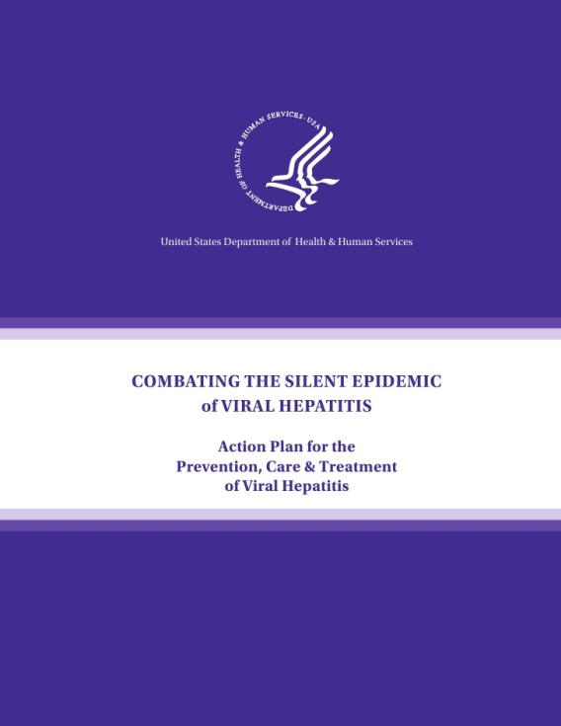
The Evolution of Our Nation’s Response
2011 2014 2017
Notes:
The National Viral Hepatitis Action Plan, 2017 – 2020 is built on the foundation laid by the Action Plans before it beginning in 2011. The field is evolving and so too must our national response.
With each update, we’ve refined our response.

Slide 10
National Viral Hepatitis Action Plan
A battle plan for our nation’s response
Updated for 2017 – 2020
Sets goals, priorities, and measurable targets
Describes recommended actions
Promotes transparency, and accountability
National plan for all stakeholders

Slide 11
Goals/Indicators, Strategies, Actions
Goal
Indicator | Indicator | Indicator | Indicator
Strategy
Strategy
Action
Action
Action
Action
4 Goals: The ultimate achievement toward which effort is directed
17 Indicators: measure achievement
24 Strategies: A method for obtaining a goal
91 Recommended Actions: A deed, something done
Notes:
The structure of the Action Plan has been streamlined and simplified. I’d like to take a couple of minutes to describe how the plan is laid out and some of the ways we hope this will help you to use the plan and make it work for the benefit our your programs and activities. The Action Plan describes the overall goals and provides structure by identifying recommended strategies and actions. There are 4 basic elements.
- Goals, we have 4 of them. A goal is the hoped-for outcome or the achievement that we’re working towards, like Goal 2, “prevent deaths and improve the lives of people living with viral hepatitis.”
- An indicator is how we measure progress towards our goals, it gives us a way to track progress and see if what we’re doing is working.
A strategy is the general approach or our methods to get to our goals. The actions then flow from the strategies.
An action is the activity or deed that will be completed. Actions are the policy, program, or activity that move us towards our goals.
The real work of addressing viral hepatitis in the U.S. will require us to focus on the doing, the actions that will be required to make the Action Plan a real, living document.

Slide 12
Eleven Priority Populations
Priority Populations
Baby boomers
African Americans
Men who have sex with men (MSM)
People who inject drugs (PWID)
American Indians and Alaska Natives (AI/AN)
Asian Americans and Pacific Islanders (AAPI)
People in correctional facilities
Veterans
Homeless individuals
People living with HIV
Pregnant women
Notes:
There are 11 priority populations in viral hepatitis. These populations include:
racial and ethnic groups- Asian Americans and Pacific Islanders, American Indians and Alaska Natives, and African Americans;
Groups with co-occurring health conditions or life circumstances such as PWID, PLWH, veterans, Homeless individuals; and
Groups based on age such as baby boomers.
Because the Action Plan includes both hepatitis B and hepatitis C, the number of priority populations is greater than for either infection alone, however, there is overlap among priority groups.
These groups have been identified as being disproportionately impacted because they experience higher rates of new infections, chronic infections, and/or deaths.
Focused efforts are needed for these priority populations if we are going to achieve our national viral hepatitis goals. Because of the disparities these groups experience, more progress is needed specifically within them to attain our goals. Understanding which groups are disproportionately impacted will help inform our activities and the collaborations and partnerships that will best meet the specific needs of the population.
These populations need to be considered across all the goals and strategies that we’ll be talking about next.

Slide 13
National Goals
Prevent New Viral Hepatitis Infections
Reduce Deaths and Improve the Health of People Living with Viral Hepatitis
Reduce Viral Hepatitis Health Disparities
Coordinate, Monitor, and Report on Implementation of Viral Hepatitis Actions
Notes:
These new goals are comprehensive for viral hepatitis, not pegged to one type of hepatitis or the other. Each goal can contain multiple strategies. Compared to the previous organizational structure, the goals are more streamlined yet distinct from each other.

Slide 14
Prevent New Viral Hepatitis Infections: Strategies
Increase community awareness of viral hepatitis and decrease stigma and discrimination
Build capacity and support innovation by the health care workforce to prevent viral hepatitis
Address critical data gaps and improve viral hepatitis surveillance
Achieve universal hepatitis A and hepatitis B vaccination for children and vulnerable adults
Notes:
The VHIG used evidence to identify and describe the most effective strategies to reach our goals. There are a lot of different ways to approach viral hepatitis, some are more effective and some are less so. For viral hepatitis efforts to progress and success more rapidly, the strategies described in the Action Plan are the priority strategies identified by experts. To tackle any specific issue, we may need to use more than one strategy, sometimes using multiple strategies at the same time.
For goal 1 there are 8 strategies that cover…
We don’t have time to talk in detail about each strategy but I would encourage you to look at the Action Plan where details about each strategy are described.

Slide 15
Goal 1: Strategies, cont’d.
5. Eliminate mother-to-child transmission of hepatitis B and hepatitis C
6. Ensure that people who inject drugs have access to viral hepatitis prevention services
7. Reduce the transmission of viral hepatitis in health care settings among patients and health care workers
8. Conduct research leading to new or improved viral hepatitis vaccines, diagnostic tests, and treatments, and the optimal use of existing tools to prevent, detect, and treat viral hepatitis
Notes:
The final strategy identified as a priority for viral hepatitis prevention is research. Research on effective prevention programs and activities will provide further evidence on model programs, scientific advances, and clinical recommendations affecting every other strategy in this goal.

Slide 16
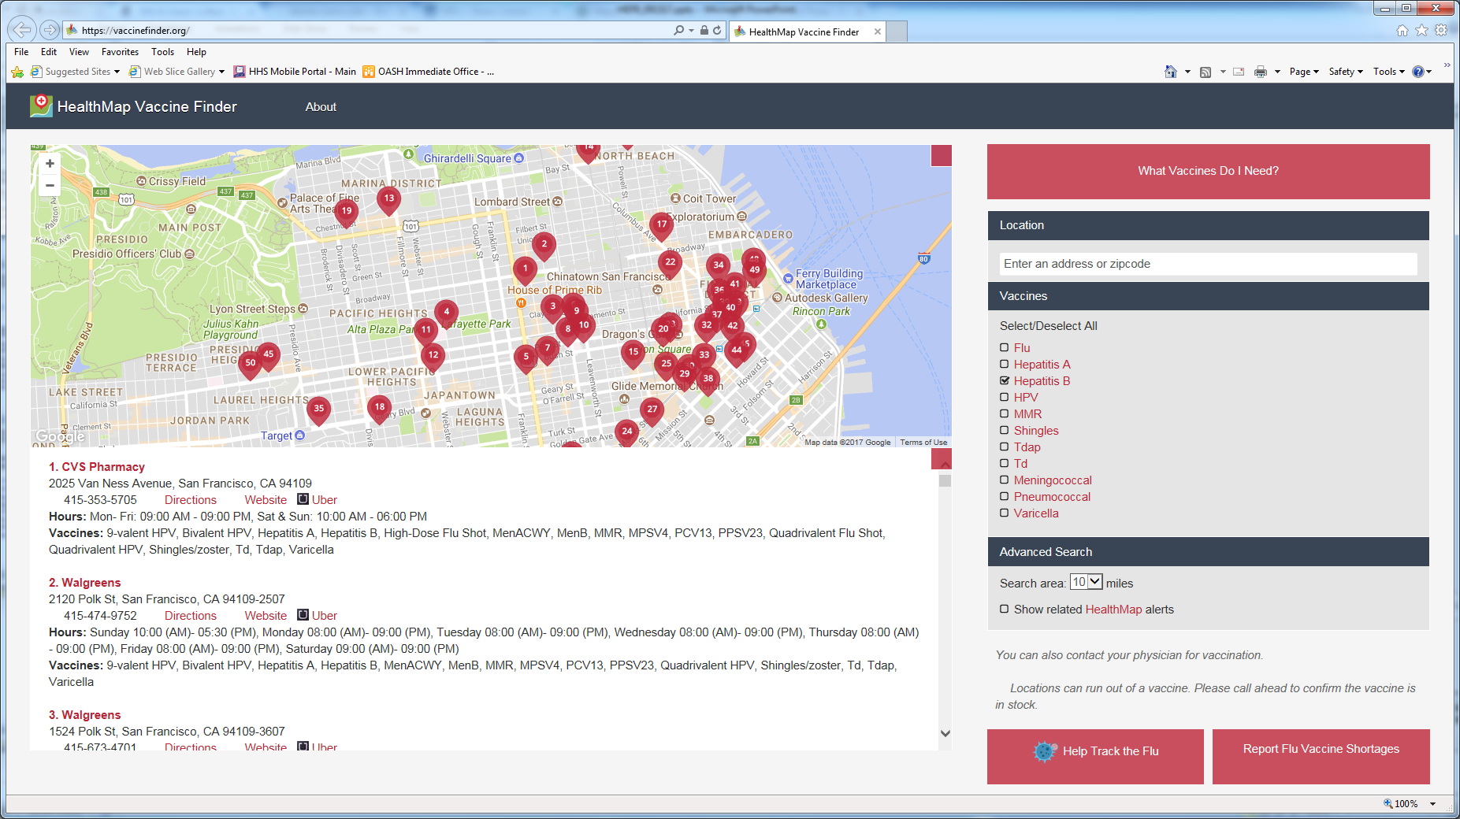
Strategy 1.4: Achieve Universal Hepatitis B Vaccination for Children and Vulnerable Adults
Develop collaborative programs to promote vaccination among priority populations
Assess vaccination status and risk and offer vaccination to all seeking protection from HBV
Encourage individuals to use the National Vaccine Finder and get vaccinated

Slide 17
Collective Efforts
We can only achieve our vision if we all do our part and work effectively and strategically with each other.
Notes:
There are a lot of people who have contributed to this work and many of you are on the webinar today.
We are thrilled to have both federal and non federal partners in the fight against viral hepatitis because
We can’t do this alone, we know that we can only achieve our vision if we all do our part and work with each other.
Today, we only have time to hear from a limited number of partners and we asked one of our federal partners to join the webinar today.
With all of the partners

Slide 18
For more information, resources, and updates, please visit:
www.hhs.gov/hepatitis

