Slide 1
Evaluating New HBV Treatments
SF HBV Free
Robert G Gish MD
Professor Consultant
Stanford University

Slide 2
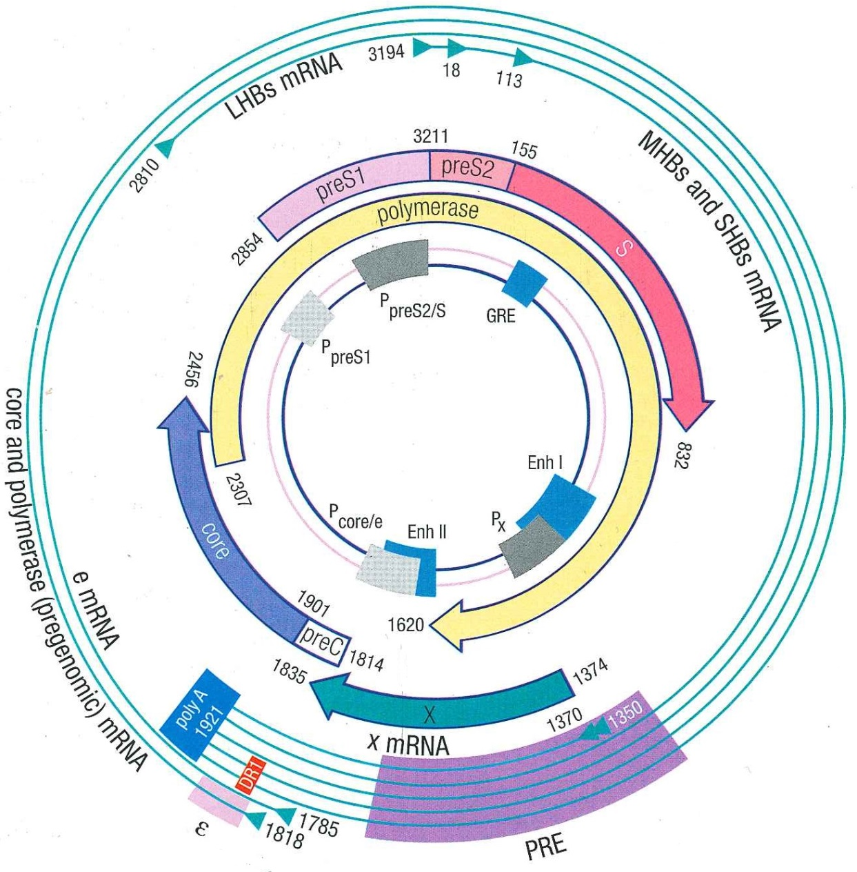
HBV a complex and compact virus
Kann, M. In Hepatitis B Virus. 1st Ed. Edited by CL Lai & S Locarnini 2002, pages 9-22

Slide 3
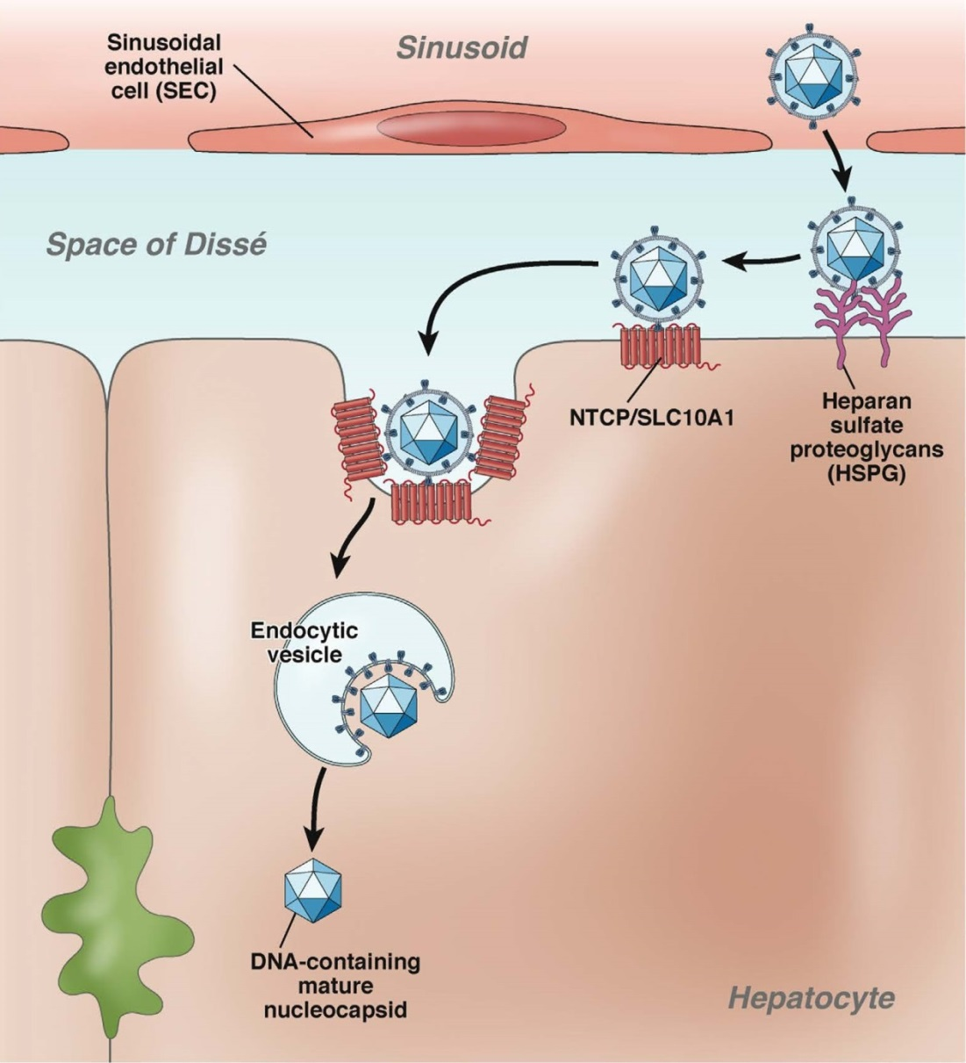
HBV Attachment and Entry into Hepatocytes
Urban, S et al 2014. Gastroenterol;147:48-64
NTCP = high affinity receptor for HBV
*Yan et al, eLife, November 2012

Slide 4
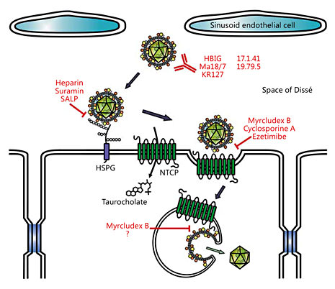
Inhibitors of HBV Attachment and Entry
Sodium taurocholate cotransporting polypeptide (NTCP) identified as HBV and HDV receptor in 2012
Myrcludex in phase 2 trials in chronic HBV and chronic HDV decrease in HBV DNA and HDV RNA
Yan H, Elife 2012; 1:e00049
Lempp RA, Urban S. Intervirol 2014’; 57: 151

Slide 5
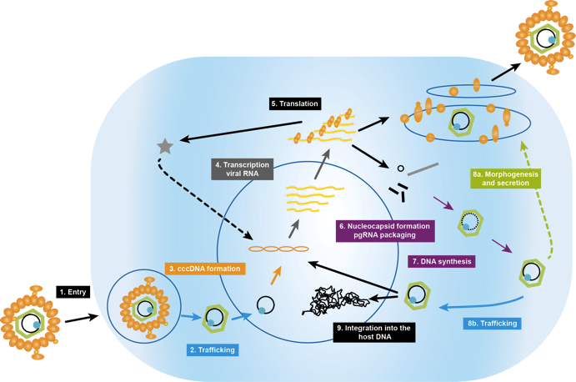
Target Polymerase
Surface
proteins
Polymerase inhibitors
Nucleotide analogues, e.g. TAF Gilead, LB80380
RNAseH inhibitors
HBx
Polymerase
pgRNA
Core
cccDNA
NTCP
Best Suited
HepG2/Huh7 transfection models (high level viral replication) may be preferable to current NTCP-HepG2 or PHH /HepaRG infection models.
rcDNA
Endosome
Zoulim F, et al. Antiviral Res 2012;96(2):256–9; HBF Drug Watch, Available at: http://www.hepb.org/professionals/hbf_drug_watch.htm.

Slide 6
Target Nucleocapsid Assembly
Surface
proteins
HBx
Polymerase
pgRNA
Core
cccDNA
Best Suited
HepG2/Huh7 transfection models (high level viral replication) may be preferable to current NTCP-HepG2 or PHH infection models.
NTCP
rcDNA
Endosome
Inhibition of nucleocapsid assembly, Novira, AssemblyBiosc, Gilead, Janssen, Roche
Zoulim F, et al. Antiviral Res 2012;96(2):256–9; HBF Drug Watch, Available at: http://www.hepb.org/professionals/hbf_drug_watch.htm.

Slide 7
Molecular Based Therapy: RNAi
RNA interference,
Arrowhead, Arbutus, Alnylam, GSK
Best Suited
If in vitro studies are performed they should be done using the NTCP infection model, to determine the impact of siRNAs on cccDNA (or integrant) mediated HBsAg expression.
Surface
proteins
HBx
Polymerase
pgRNA
Core
cIAP antagonist- Birinapant
cccDNA
NTCP
rcDNA
Endosome
Zoulim F, et al. Antiviral Res 2012;96(2):256–9; HBF Drug Watch, Available at: http://www.hepb.org/professionals/hbf_drug_watch.htm.

Slide 8
Target: HBsAg
Targeting HBsAg
Mab: Gilead
RNAi Therapies
Surface
proteins
HBx
Polymerase
pgRNA
Best Suited
Infection models (PHH, HepaRG, NTCP-HepG2)
which permit studies on the impact of cccDNA generated HBsAg (instead of plasmid generated HBsAg in transfection models
Core
cccDNA
NTCP
rcDNA
Endosome
Zoulim F, et al. Antiviral Res 2012;96(2):256–9; HBF Drug Watch, Available at: http://www.hepb.org/professionals/hbf_drug_watch.htm.

Slide 9
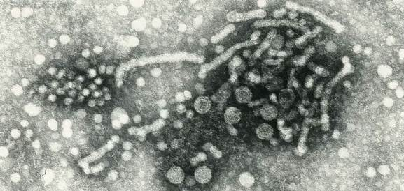
Immune Regulation by HBsAg
HBsAg secreted in vast excess over virions (>10³ fold)
Circulate in blood 100-400 μg/ml
(1% of total serum protein)
Unique conformational structure (8 cysteines and 8 prolines )
Associated with increased risk of HCC (Yuen, MF. et al 2008. Gastro;135:1192–1199)
Plays a key role in HBV persistence
Suppress both innate (TLR-2, TLR-9 and IFN-α) as well as adaptive (mDC) responses to infection
Wang, S et al 2013. J Immunol;190:5142.; Xu, Y et al 2009. Mol Immunol;46:2640.; Op den Brouw, ML et al 2009. Immunol;126:280.

Slide 10
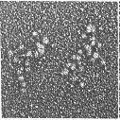


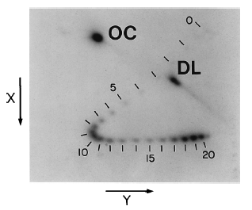
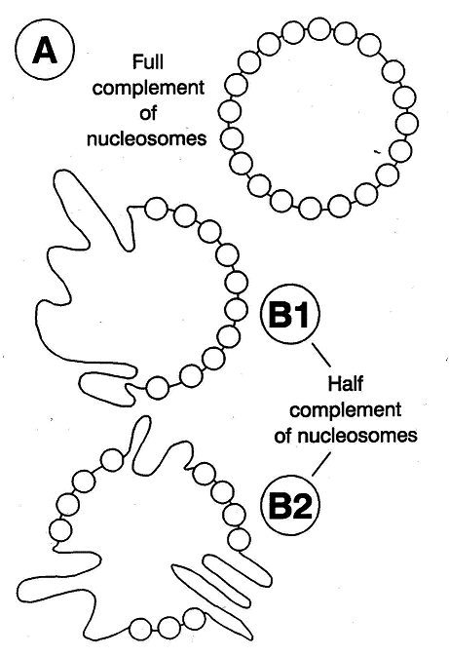
The cccDNA is a Minichromosome
Low Replication
Phenotype
Quiescent or active
Medium to Low Viraemia
High Replication
Phenotype
Transcriptionally Active
High Viraemia
Bock, T. et al 1994. Virus Genes;8:215
Bock, T. et al 2001. JMB;307:183
Newbold, J and Locarnini, S 1995. J. Virol;69:3350

Slide 11
Minichromosome (cccDNA Generation and Processing)
Surface
proteins
HBx
Polymerase
pgRNA
Core
cIAP antagonist- Birinapant
cccDNA
NTCP
Best Suited
NTCP HepG2 infection model, PHH, HepaRG.
-1mer transfection model should also be considered.
rcDNA
Endosome
Targeting cccDNA
Eg CRISPR,
Talens
HDACi
Zoulim F, et al. Antiviral Res 2012;96(2):256–9; HBF Drug Watch, Available at: http://www.hepb.org/professionals/hbf_drug_watch.htm.

Slide 12
In vitro Models for Studying cccDNA
HepaRG
PHH
[infection]
NTCP
HepG2
HepaRG
[infection]
HepG2
HBV 1.0
[transfection]
HepG2
HBV H1.3
[stable]
HepG2
AD38
[inducible]
HBV
cccDNA formation | cccDNA | Y | Y | N | N | Y/N
cccDNA chromatin assembly | cccDNA ChIP | Y/N * | Y/N* | N | N | Y
cccDNA chromatin function | cccDNA ChIP | Y/N* | Y/N* | Y/N* | Y/N | Y
cccDNA stability | cccDNA | Y/N | Y/N | Y/N | Y | N
cccDNA transcription | pgRNA | Y | Y | Y | Y/N | Y/N
Core particles recycling |  | Y | Y | Y/N | Y | Y
HBV replication | Cp HBV-DNA | Y | Y | Y | Y | Y
Chronic infection |  | N | Y/N | Y | Y/N | Y/N
Slide provided by Prof. Massimo Levrero
* inferred; direct study limited by cccDNA levels

Slide 13
Target & Drug Discovery to Cure HBV Infection
Innate Immunity
RIG-I
TLRs
NOD
NK/NK T-cells
Surface
proteins
HBx
Polymerase
pgRNA
Core
Adaptive Immunity *
CD4/CD8
B-cells
cIAP antagonist- Birinapant
cccDNA
NTCP
rcDNA
Endosome
* Hoh, A et al 2015. J Virol;89:7433
Zoulim F, et al. Antiviral Res 2012;96(2):256–9; HBF Drug Watch, Available at: http://www.hepb.org/professionals/hbf_drug_watch.htm.
Slide provided by Prof. Fabien Zoulim

Slide 14

Geographic distribution of HBV genotypes
A2
D
A2
C
G
G
D
A2
D
Bj/B1
Ba
B
E
H
F
A1
A2B
C
D
Also A1, E
Modified from Spradling, PR et al 2014. In Viral Hepatitis, 4th Edition. 81-95

Slide 15
HBV Genotypes
To date, 9 different genotypes have been identified (A to I- plus “minor genotype” J), based on nucleotide sequence divergence of at least 8% over the complete genome.
The different genotypes have a geographically restricted distribution and differ widely in natural history, disease progression and response to therapy.
Chronic HBV should not be considered a “one size fits all disease” BECAUSE…….

Slide 16
HBV genotype influences natural history, disease progression, response to therapy and replication phenotype.

Slide 17
Terminology for Pharmacological Interactions
Between Drugs in Combination
(when the individual components are active alone)
If the observed combined effect is
greater than | the same as | less than
what has been predicted based on individual concentration-response plots, the combined effect can be described as
synergistic | additive | antagonistic
Observed interactions may be different at different drug concentration ratios and at different time points.
Diagnosis of interaction depends on the reference model used to define additivity (i.e. non-interaction).
There are two generally accepted alternative definitions….

Slide 18
Conclusion
Although major advances have been made in the establishment of in vitro models which permit studies of the complete HBV lifecycle, much improved and more robust models are urgently required to permit studies on the impact of new treatments and curative regimens on different HBV genotypes, as well as novel variants associated with different stages of HBV natural history (eg HBeAg negative CHB).

Slide 19
Acknowledgments
Stephen Locarnini

