Slide 1
Looking to the Future: Forthcoming Vaccine Milestones
Moon S. Chen, Jr., Ph.D., M.P.H.
Professor & Associate Director, Cancer Control/Cancer Health Disparities
UC Davis Comprehensive Cancer Center
Sacramento, CA

Slide 3
Questions to be answered:
1. What are our aspirations for improving the uptake of vax?
Achievable through basic science research and technology?
Achievable through provider education?
Achievable through public education and advocacy?
2. Given the higher uptake of HBV vax vs HPV vax, what accounts for the differences and what might be leveraged because of the commonalities between HBV vax and HPV vax?
3. What can we do to apply our aspirations towards improving the uptake of HPV and HBV vax?

Slide 4
Questions to be answered:
What are our aspirations for improving the uptake of vax?
Achievable through basic science research and technology?

Slide 5
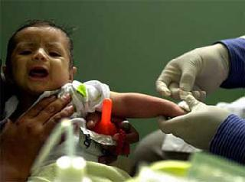

Slide 6
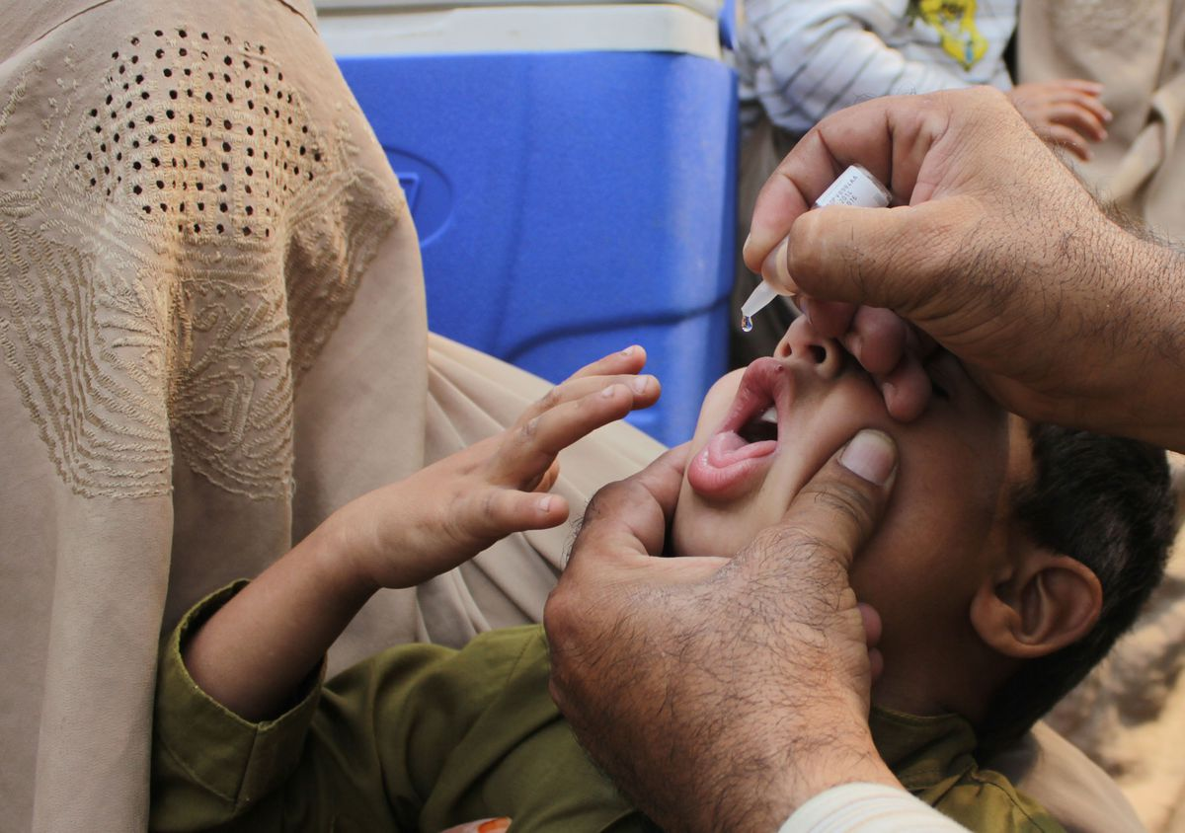

Slide 7
Questions to be answered:
What are our aspirations for improving the uptake of vax?
Achievable through provider education?

Slide 8
Encourage provider leadership

Slide 9
Questions to be answered:
What are our aspirations for improving the uptake of vax?
Achievable through public education and advocacy?

Slide 10
Public Education & Advocacy

Slide 11
Questions to be answered:
Given the higher uptake of HBV vax vs HPV vax:
What accounts for the differences?
What might be leveraged because of the commonalities between HBV vax and HPV vax?

Slide 12
Differences: Comparing HBV and HPV
Adminstration: at birth versus pre-adolescent
Required: school entry versus not required
Uptake rates: 90% for HBV versus <50%

Slide 13
Commonalities: Comparing HBV, HPV, & smallpox
Reservoir: occurs only in humans
Etiology: all are viruses
Transmission: infectious
Prevention: all vaccine-preventable
Potential: Can be eradicated?

Slide 14
Questions to be answered:
What can we do to apply our aspirations towards improving the uptake of HPV and HBV vax?

Slide 15
Messaging
Provider pivotal
“Routine-ize”
Cancer prevention
HBV vaccinations
Increasing Uptake of Vaccine Preventable Cancers
HPV vaccinations
Means
Educated Public
Single dosing, oral
Administer at birth

Slide 17
Notes:
Challenges & Opportunites in Reducing Disparities Posed by Hepatitis Viruses
Feb 4, 2009 AACR The Science of Cancer Health Disparities
17

